Slide 2
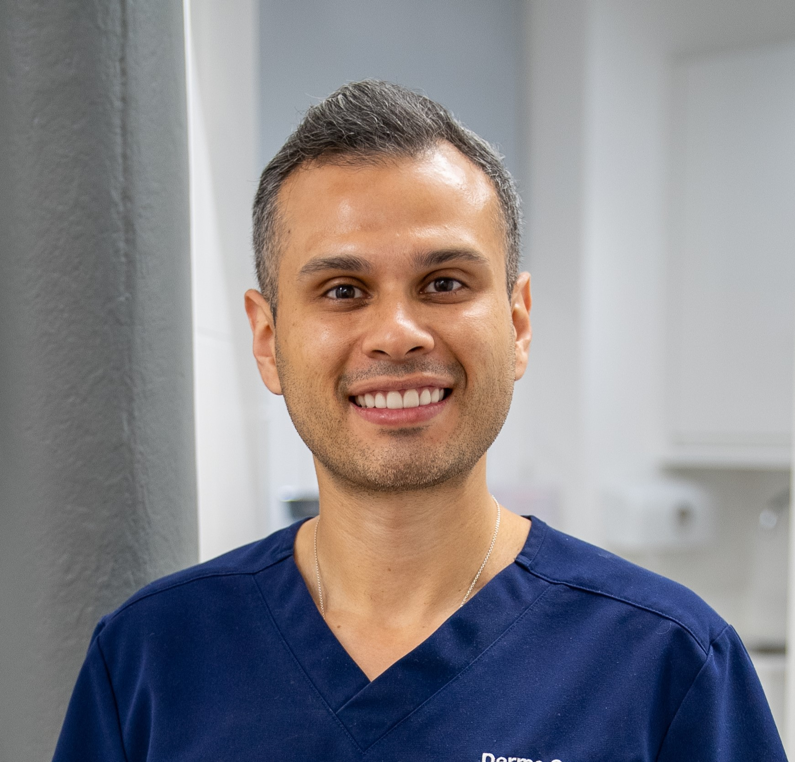
Yobany Valencia
NMC Registered Nurse
Advanced Aesthetic Practitioner
Founder of ‘Derma Consult Skin Specialist’ Clinic
Wealth of experience from NHS as Dermatology and Skin Cancer Nurse
Trainer at Interface Aesthetics

Slide 3
Dr Felix Karst
Dual qualified Doctor and Dentist
OMFS Specialist Trainee MaxFax Registrar
Member of the Royal College of Surgeons
Member of the German Society for Botulinum Toxin and Filler Treatment
Trainer at Interface Aesthetics
4 Years of experience in NSA

Slide 4
Skin Physiology

Slide 5
Epidermis
Stratified squamous epithelium
Keratinocytes 95% Melanocytes
Langerhans cells and Merkel cells
5 Layers
Stratum Corneum
Sytratus Lucidum
Stratum Granulosum
Stratum Spinosum
Stratum Basale

Slide 6
Dermis
Dermis
Between epidermis and subcutaneous
Varies from 1mm-4mm
Collagen, Elastin fibres, Ground fibres
Fibroblasts
Produce dermal connective tissue
Gradually reduce during ageing or mature skin
Structures
Blood vessels, Lymphatics, Nerves

Slide 7
Dermis - Melanocytes
Melanocytes
Produce pigment
No difference in number or distribution between races
Colour determined by production
Stored in nearby keratinocytes
Melanosomes
Exposure to UVB increases melanogenesis

Slide 8
Anatomy of
the face

Slide 9
Polynucleotides:
Clinical Studies and
Biological Effects

Slide 10
since
1986
applied in official medicine
Polynucleotides fundamental
scientific
evidence base
more than
90
clinical studies and publications
34
randomised comparative trials

Slide 11
What is a polynucleotide?
Polynucleotides are DNA fragments, polymers formed through condensation of monomers called deoxyribonucleotides
Deoxyribonucleotides are made of three parts:
1) A nitrogenous base
Purine bases: adenine, guanine
Pyrimidine bases: cytosine, timine
2) Pentose sugar
Deoxyribose
3) One or more phosphate groups

Slide 12
Initial action of Polynucleotides-HPT ®
Polynucleotides-HPT® are forming a three-dimensional gel which contributes to:
Skin moisturizing (hydration)
Improvement of skin viscoelasticity
Initial turgidity

Slide 13
Polynucleotides HPT® Action
Polynucleotides HPT® break down in nucleotides, nucleosides and further molecular fragments.
They enrich extracellular dermal space of energy and trophic substrates
Promoting physiologic cell reparation, mainly of fibroblasts

Slide 14
Degradation of Polynucleotides-HPT ®
Physiological degradation of Polynucleotides-HPT® is the key process for their trophic action, increasing their bioavailability at cellular level.
Progressive decrease of the molecular weight
Progressive decrease of the molecular weight
Polynucleotides-HPT ® are natural molecules, biocompatible and reabsorbable, entering the physiologic catabolism of nucleic acids.

Slide 15
What are the reasons for such popularity?

Slide 16
2-
Regenerative
3- Synthesis of collagen and
elastin
1- Stimulate Cell Proliferation
Polynucleotide
Biological
Effects
PN HPT®
4- Synthesis of Hyaluronic Acid
8- Restore Fibroblast Biosynthetic Activity
6- Melanogenesis
Inhibition
Notes:
1- PDRN acts on adenosine receptors but can also promote cell proliferation by providing new “building blocks” for cells through salvage pathway
2-PDRN is known in the clinical field for its regenerative properties. This action is partially related to the stimulation of the purinergic system through adenosine A2A receptors (A2ARs)
3- due to the stimulation of fibroblasts also collagen and elastin are boosted
4- thanks to adenosine stimulation
5- PDRN acts by engaging adenosine A2 receptors (A2ARs), key players in promoting wound healing and neovascularization.
6- led to decreases in melanin content, tyrosinase activity, and MITF and TRP-1 expression with concomitant increases in phosphorylated forms of extracellular signal-regulated protein kinase (ERK) and AKT in mouse melanocytes
7- PDRN could be a therapeutic tool to control inflammation through A2AR stimulation.
‹#›

Slide 17
Clinical
Researches
PN HPT®

Slide 18
The criteria of polynucleotides efficacy and safety
The level of PN purification depends on:
Source of the product
Technologies of production which guarantees a degree of safety
Notes:
The source of the product could be salmon or trout
‹#›

Slide 19
Raw material source
Trout gonads
Trentino Alto Adige - Italy
Notes:
Cruelty Free, no suitable for vegans.

Slide 20
Innovated HPT® technology
from Mastelli
Pure PN without peptides, proteins, lipids
Trout
DNA extraction
Ultra purification, final sterilization
Notes:
Cleaning technology - PPM technology from IRA Lab and HPT from Mastelli Pharmaceutical. In the result, we are consuming an absolutely pure product without the presence of proteins, peptides, toxins.
This increases the safety of the product.
‹#›

Slide 21
When to choose polynucleotides HPT®?
Dehydrated and damaged
skin
any age
Acne scars, atrophic scars
Androgenetic alopecia, hair loss and thinning hair
Before and after surgery
(included hair transplant)
Notes:
‹#›

Slide 22
Mastelli laboratory
Results: Preclinical Examinations
Crimean State Medical University S.I. Georgievski - 2017
Notes:
‹#›

Slide 23
Mastelli | Heritage
Established in 1952
as a pharmaceutical company
in Sanremo, Italy.
In 2005, it launched into the aesthetic market
Pioneer and originator
in the use of PDRN and polynucleotides
for regenerative treatments
Over 70 years of activity
always carried out by combining tradition, research and innovation
Mastelli-owned original extraction technology from raw material
that uses innovative HPT to ensure a high level of quality, safety and purity¹

Slide 25
PN-HPT® promote
cell regeneration

Slide 26
PN-HPT® increase fibroblast viability
PN promote a trophic and stimulating action on existing fibroblasts, thus increasing their viability
Fibroblast viability levels are significantly higher in presence of PN compared with control after 96 hours and after 1 week (p<0.001)
*p<0.001
Adapted from Colangelo MT et al. J Biol Regul Homeost Agents. 2021; 35:355─362.
Notes:
‹#›

Slide 27
PN-HPT® increase fibroblast number
PN stimulated cell proliferation, increasing the number of new fibroblasts
Number of fibroblast cells were significantly higher in presence of PN compared with control at 96 hours and 1 week (p<0.001)
*p<0.001
Adapted from Colangelo MT et al. J Biol Regul Homeost Agents. 2021; 35:355─362.

Slide 28
PN-HPT® enhance fibroblast proliferation
PN increase the number of human fibroblast cells in vitro scratch test
A visibly higher number of cells
bridge in the scratch area with PN at 96 hours and 1 week (p<0.001)
Transmitted light micrographs of scratch test assay
Colangelo MT et al. J Biol Regul Homeost Agents. 2021; 35:355─362.

Slide 29
PN-HPT® increase collagen synthesis
PN increased synthesis of Type I and Type III collagen
Synthesis of Type I and Type III collagen was significantly increased after 1 week (p<0.01)
In vitro study: The presence of Type I and III collagen was
assessed in the supernatant of cell cultures of fibroblasts
*p<0.01
Adapted from Colangelo MT et al. J Biol Regul Homeost Agents. 2021; 35:355─362.

Slide 30
Focus on collagen fibres
CONTROL
HA
PN-HPT®
PN-HPT® promote an increased and better organization of collagen fibres compared to treatments with HA and compared to the control.

Slide 31
Summarize the results
Effective in the correction related skin changes, aging, hyperpigmentation,mild rosacea
Works perfectly well in acne symptom complex treatment
Smooths and
relieves damaged skin

Slide 32
What is “Skin Priming”?
Notes:
‹#›

Slide 33
What is “Skin Priming”?

Slide 34
Summary

Slide 35
Polynucleotides HPT® vs Skin Boosters
Treated areas: face, neck, decollete, hands, body, scalp, intimate areas
Active ingredients: Purifyed PN
EFFECTS: enhances fibroblast production, induces tissue repair processes, regulates melanogenesis, promotes hydration, promote myofibroblast
DOWSIDES: doesn’t give volume, no immediate results
Treated areas: face, neck, decollete,
hands body.
Active ingredients: Hyaluronic Acid (HA), amino acids, peptides
EFFECTS: give volume, hydration, filling effect, lift effect
DOWNSIDES: no regeneration action, short term effect

Slide 36
Summary

Slide 37
Remember:
Polynucleotide HPT® or PN is a Regenerative Medicine tool not a skin booster
PN HPT® can:
enhance the production of fibroblasts and myofibroblasts
reverse aging
increase collagen
increase elastin
regenerate the skin
reduce scars
reduce hyperpigmentation

Slide 38
Protocols and
Techniques

Slide 39
Needle vs Cannula
Needle
Treated areas: face, neck, decollete, hands, body, scalp, intimate areas
Injection technique: micro bolus
Injection depth: intradermal
Effects: the mechanical action of the needle induces activation of natural tissue repair processes
Downsides: bolus are visible for few days, it could bruise
Cannula
Treated areas: face, neck, decollete, hands, body
Injection technique: linear
Injection depth: subdermal
Effects: faster, painless, less bruising, temporary lifting effect
Downsides: gradual absorption of the product
Notes:
Differences between needle technique and cannula technique
‹#›

Slide 40
Face treatments and techniques
Face treatments and techniques

Slide 41
Highly purified polynucleotides (PN-HPT®)
20 mg/ml
Available in 2ml syringe
With two 30G ½ needles
Medical device CE 0373

Slide 42
Where and what can PLINEST® be used for?
Anatomical areas and type of skin:

Slide 43
How to use it - Full Face needle
Depth of injection:
Intradermal
Injection technique:
Microdroplet, linear or fan technique
Protocol:
Younger Patients: One session every 21 days for a total of 3 sessions
Advanced Skin Aging: One session every 21 days for a total of 4 sessions
Maintenance:
One session every 6 months (2 cycles a year)
Micro bolus technique
Retrograde linear technique

Slide 44
Full Face - Cannula
Number of treatments: 3-4
Interval: 4 weeks apart
Injection depth: Subcutaneous - 0,2ml each thread
Cannula fanning technique
Protocol could be different depends on doctor recommendation, patient’s age and skin type. Maintenance protocol has to be repeated every 4-6 months (it can vary depends on doctor’s advice recommendation).
Notes:
40mg or 50mg can be used on face depending on the severity of the problem and on the age of the patient
‹#›

Slide 45
Full Face
Photo and chrono aging
Polynucleotides 40mg, 2ml subdermal,
2 sessions
Picture courtesy of Dr Ioannis Liakas - Vie Asthetics
BEFORE
AFTER
Notes:
‹#›

Slide 46
Full Face
Rosacea
Polynucleotides 40mg
Intradermal, 2 sessions with interval 3 weeks
Picture courtesy of DermaFocus - UK
Notes:
‹#›

Slide 47
Neck - Needle and cannula
Micro Bolus Technique
Retrograde linear technique
Number of treatments: 3-4
Interval: 3-4 weeks apart
Injection depth: intradermal/subcutaneous
Protocol could be different depends on doctor recommendation, patient’s age and skin type. Maintenance protocol has to be repeated every 4-6 months (it can vary depends on doctor’s advice recommendation).
Notes:
50mg of PN is the best product to use on neck
‹#›

Slide 48
Decolletage - Needle and cannula
Micro Bolus Technique
Retrograde linear technique
Number of treatments: 3-4
Interval: 3-4 weeks apart
Injection depth: intradermal/subcutaneous
Protocol could be different depends on doctor recommendation, patient’s age and skin type. Maintenance protocol has to be repeated every 4-6 months (it can vary depends on doctor’s advice recommendation).
Notes:
On the decollete is recommended to inject the highest concentration of PN (50mg)
It can be used the mixed techniques with cannula and microbolus
‹#›

Slide 49
Neck
Photo and chrono aging
Plinest, micro bolus,
4 sessions + Dermalux
Pictures courtesy of Kate Monteith Ross - LaRoss Aesthetic
Notes:
‹#›

Slide 50
Neck
Plinest
micro bolus, 3 sessions
Pictures courtesy of Dr Amy Law

Slide 51
Neck
Notes:
‹#›

Slide 52
Decollete
Notes:
‹#›

Slide 53
Periorbital area treatments and techniques
Periorbital area
treatments and techniques

Slide 54
Highly purified polynucleotides (PN-HPT ®)
7,5 mg/ml
Available in 2 ml syringe
With two 30G ½ needles
Medical device CE 0373

Slide 55
Where and what can PLINEST®eye be used for?
Anatomical areas and type of skin:
For:
To improve the quality of the skin in younger and more mature patients through moisturization, facilitated trophism, improving turgidity, tonicity and suppleness.

Slide 56
How to use it - Needle
Depth of injection:
Intradermal
Injection technique:
Microdroplet/ Retrograde linear technique
Protocol:
One session every 21 days for a total of 3-4 sessions
Maintenance:
One session every 6 months (2 cycles a year)
Micro bolus technique
Butterfly pattern - micro bolus

Slide 57
Periorbital Area - Cannula
Number of treatments: 3-4
Interval: 4 weeks apart
Injection depth: Subcutaneous - 0,2ml each thread
Cannula fanning technique
Protocol could be different depends on doctor recommendation, patient’s age and skin type. Maintenance protocol has to be repeated every 4-6 months (it can vary depends on doctor’s advice recommendation).

Slide 58
Eye contour
Periorbital area
Plinest Eye, Intradermal,
3 sessions,
Picture courtesy Lynsey Atkinson - Nurse Prescriber
Notes:
Periorbital area damaged by a botched treatment (RF)
PN 40mg
‹#›

Slide 59
Highly Purified Polynucleotides (PN-HPT®) 10 mg/ml
Non-crosslinked hyaluronic acid 10mg/ml
Mannitol
Available in 2 ml syringe
Two 30G ½ needles
Medical device CE 0373

Slide 60
Where and what can NEWEST®
be used for?
Anatomical areas:
For:
To improve the quality of the skin in younger and more mature patients through moisturization, facilitated trophism, improving turgidity, and suppleness.
Remodeling striae distensae (stretch marks) the depressed scars
Type of skin:

Slide 61
Lower Face
Photo and Chrono aging
Newest, 1 session
Pictures courtesy of Jen Barckley Aesthetics
Notes:
‹#›

Slide 62
Protocols
Notes:
‹#›

Slide 63
Product options:
20mg/2ml of Polynucleotides HPT® + 20mg of linear HA + mannitol
Indication: hydration, acne prone skin, prevent aging
Treated areas: face, neck, decollete
40mg/2ml of Polynucleotides HPT®
Indication : prevention, moderate aging, mild rosacea, couperose
Treated areas : face, periorbital area, neck, décolleté, hands
15mg/2ml of Polynucleotides HPT®
Indication : prevention, fine lines, dark circles
Treated areas : periorbital area, tear trough
15mg/2ml of Polynucleotides HPT®
Indication : prevention, hair loss, thinning hair
Treated areas : scalp, eyebrows

Slide 64
Regenerative
IMPROVE SKIN TEXTURE ON VERY DAMAGED FACE, NECK AND DECOLLETAGE
Polynucleotides HPT® 7,5 - 10 - 20 mg
Day 20
Session 2
Day 60
Session 4
(Maintenance)
Day 0
Session 1
Day 40
Session 3
Protocol could be different depends on doctor recommendation, patient’s age and skin type. Maintenance protocol has to be repeated every 3-6 months (it can vary depends on doctor’s advice recommendation).
Notes:
For younger skin 3 sessions , for more mature skin 4 sessions
‹#›

Slide 65
Remember:
You can use microbolus or cannula technique
Microbolus is recommended on neck and upper eyelid
Face can be treated either with 40mg and 50mg
Microbolus injections are intradermal
Cannula injections are subdermal
One treatment every for 3-4 weeks for 3-4 times

Slide 66
COMBINED PROTOCOLS

Slide 67
PRIMING PROTOCOL
Priming with Polynucleotides HPT®
Session 4
to be booked depending
on the procedures
Week 0
Session 1
Week 3
Session 2
Week 5
Session 3
Micronedling
Fillers
Anti Wrinkle injections
Energy based devices
Light based devices
Surgery
Chemical peels
Microneedling
Fillers
Anti Wrinkle injections
Energy based devices
Light based devices
Surgery
Chemical peels
Polynucleotides HPT®
40mg
Polynucleotides HPT®
40mg
Protocol could be different depends on doctor recommendation, patient’s age and skin type. Maintenance protocol has to be repeated every 6 months (it can vary depends on doctor’s advice recommendation).

Slide 68
IMPROVE SKIN TEXTURE, ANTI AGE, PLUMP AND LIFT EFFECT
Combined Regeneration
Polynucleotides HPT®+ Skin Booster
Day 0
Session 1
Day 14
Session 2
Day 28
Session 3
Day 32
Session 4
Polynucleotides HPT®
Skin Booster
Polynucleotides HPT®
Skin Booster
Protocol could be different depends on doctor recommendation, patient’s age and skin type. Maintenance protocol has to be repeated every 3-6 months (it can vary depends on doctor’s advice recommendation).
Notes:
Any skin boosters can be used in combination with PN.
There is the option to use the 2 product in the same session
‹#›

Slide 69
Remember:
Polynucleotides can be combined with:
any aesthetic procedures
any injectables
to prep the skin before treatments
as an enhancement to other aesthetic procedures

Slide 70
What do expect after the treatment
After the injection we can experience:
slight swelling
redness
bruises
sense of warmth in the treated areas
These sides effects pass on their own after a few hours/days it depends on the strength of the product

Slide 71
Side Effects and Adverse reactions
There are no serious side effects .
Intradermal long chain PN filler injection seems to be an effective and safe treatment for skin rejuvenation.
Long-chain polynucleotide filler for skin rejuvenation: efficacy and complications in five patients - PubMed (nih.gov)

Slide 72
Contraindication
Breast feeding
Active Cancer
Pregnancy
Fish allergy it actually belongs to the risk/benefit evaluation that doctors are expected to apply for any kind of treatment and medical/surgical procedure; however, patients have to be properly questioned about existing allergies during the medical anamnesis/interview and fish allergy has to be identified."

Slide 73
Aftercare
Avoid touching the treated area for 6 hours after the treatment.
After that the area can be washed with a gentle cleanser.
Avoid make up or cream on the treated area for 24 hours
Until the initial swelling and redness have resolved, do not expose the treated area to intense heat (eg. Sauna, steam rooms, hot showers and sunbathing) or extreme cold.
Avoid strenuous exercise and swimming to avoid risks of infection
Avoid alcohol consumption for 24 hours before and after treatment .
Apply SPF50 sunscreen
Schedule your next appointment in 21 days

