Slide 1


New Trends in Aesthetic Medicine:
for a more radiant and rejuvenated skin using PhilArt

Slide 2
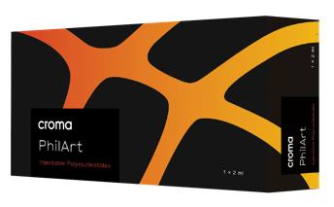
Agenda
Introducing Polynucleotides
  What are Polynucleotides?
  How do the polynucleotides work?
Polynucleotides in your aesthetic practice
  Facial assessment
  The PhilArt portfolio
Q&A
Strictly for internal use only.

Slide 3
KOL / Trainer
Bio & Disclaimer
Strictly for internal use only.

Slide 4
Housekeeping
Fire Exit
Bathroom
No photography without consent

Slide 5


Introducing polynucleotides

Slide 6
What are Polynucleotides & how do they work?

Slide 7
Science & technology evolution behind polynucleotides:
from wound healing to aesthetic indications
2003
2019
2020
2021
2004
2015
Based on top standard biotechnologies, refined over 70 years, the first medical devices have been manufactured according to patented PN-HPT® technology from trout gonad DNA and introduced in Italy
Polynucleotide therapy, resulted in a significant improvement in skin quality, including increased hydration, elasticity, and reduced wrinkle dept⁴
Polynucleotide filler with lidocaine can be a safe and effective alternative to hyaluronic acid filler for facial rejuvenation.³
Introduction of polynucleotide-based hair restoration treatments⁵
Using polynucleotide fillers for facial rejuvenation improved skin hydration, elasticity, and texture, and also stimulated collagen production.
The combination of polynucleotides with hyaluronic acid showed a longer-lasting effect than hyaluronic acid alone²
Introduction of polydeoxyribonucleotide (PDRN) as the first polynucleotide product for skin rejuvenation and wound healing.¹
Consensus report recommends for Polynucleotide use in various cosmetic procedures
1 Hong YJ, Kim HJ, Kim JH, et al. Effect of polydeoxyribonucleotide on the survival of random-pattern skin flaps in rats. Ann Plast Surg. 2003;51(3):288-294. doi: 10.1097/01.SAP.0000078515.75811.2F.
2 Domenico Russo, MD, PhD and Daniela Francesca Piraccini, MD: Polydeoxyribonucleotide (PDRN) in Aesthetic Medicine: A Series of Cases“ published in Journal of Cosmetic and Laser Therapy in 2015.
3 Hwang HS, Lee JH, Kim BJ, et al. Efficacy and safety of polynucleotide filler with lidocaine for the correction of nasolabial fold: a randomized, prospective, multicenter, split-face, double-blinded, non-inferiority trial. J Dermatolog Treat. 2018;29(2):114-119. doi:10.1080/09546634.2017.1313921
4 Maurizio Cavallini: Efficacy of polynucleotide therapy in improving skin quality: a randomized, controlled, multicenter trial" published in the Journal of Cosmetic Dermatology in 2019.
5 Na JI, Shin JH, Lee JS, et al. Efficacy and safety of polynucleotide hair restoration treatment in androgenetic alopecia: a randomized, multicenter, placebo-controlled study. Dermatol Surg. 2021;47(1):e83-e90. doi:10.1097/DSS.0000000000002642
Strictly for internal use only.

Slide 8
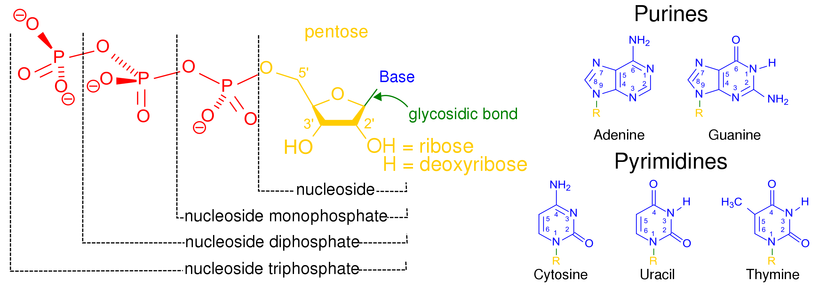
NUCLEOTIDES AND NUCLEOSIDES
Nucleotide
Strictly for internal use only.

Slide 9
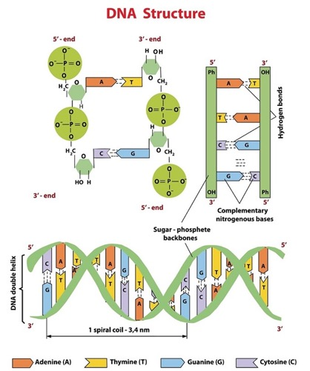
Polynucleotides (PN)
STERIC STRUCTURE
Two polynucleotide chains are linked by hydrogen bonds between the base pairs (one purine with one pyrimidine)
The polynucleotide chains are coupled to form a double helix (double stranded chain)
Strictly for internal use only.

Slide 10
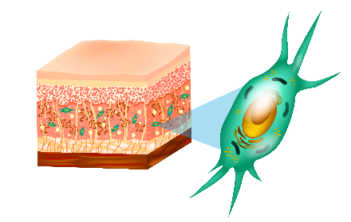
Promotes¹ HYDRATION
PN-HPT® (Polynucleotides- High Purification Technology)activities/functions
Promotes² SCAVENGING
PN-HPT®
Increased³ COLLAGEN SYNTHESIS
Increased³ viability and number of
FIBROBLASTS
¹ Bartoletti E, Cavallini M, Maioli L, Massirone A, Palmieri IP, Papagni M et al. Introduction to Polynucleotides Highly Purified Technology. Aesthetic Medicine.2020 Oct-Dec;Vol.7(1):43-47.
² Data on file
³ Collangelo MT. Govoni P, Beletti s, Squadrito F, Guizzardi S, Galli C. Polynucleotide biogel enchances tissue repair, matrix desposition and organization. J. of Biological Regulators &Homeostatic Agents. 2021;Vol35(1):355-362.
Strictly for internal use only.

Slide 11
PN-HPT® promote skin hydration and elasticity
Data showed an increased hydration and improvement of elasticity¹
Hydration
Elasticity
Improvement vs. baseline (%)
¹ Cavallini M, Papagni M. Long Chain Polynucleotides Gel and Skin Biorevitalization. International Journal of Plastic Dermatology-ISPLAD. 2007; 3(3): 27-32.
Strictly for internal use only.

Slide 12
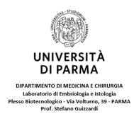
Evaluation of the scavenger activity¹ of PN, HA and PN+HA in response to oxidation induced by H₂O₂
DECREASE IN FLUORESCENCE = Decrease in free ROS in medium
The PN – HA -PN+HA with their SCAVENGER ACTIVITY capture ROS
ANTIOXIDANT ACTION
CONTROL NON- CROSS-LINKED HA PHILART PN PHILART NEXT
¹ Data on file. Colangelo MT, Guizzardi S, Galli C. Internal data 2021.
Strictly for internal use only.

Slide 13
Evaluation of the scavenger activity¹ of PN, HA and PN+HA in response to oxidation induced by H²O²
DECREASE IN FLUORESCENCE = Decrease in free ROS in medium
The PN – HA -PN+HA with their SCAVENGER ACTIVITY capture ROS
ANTIOXIDANT ACTION
CONTROL
NON -CROSS-LINKED HA
PHILART PN
PHILART NEXT
¹ Data on file. Colangelo MT, Guizzardi S, Galli C. Internal data 2021.
Strictly for internal use only.

Slide 14
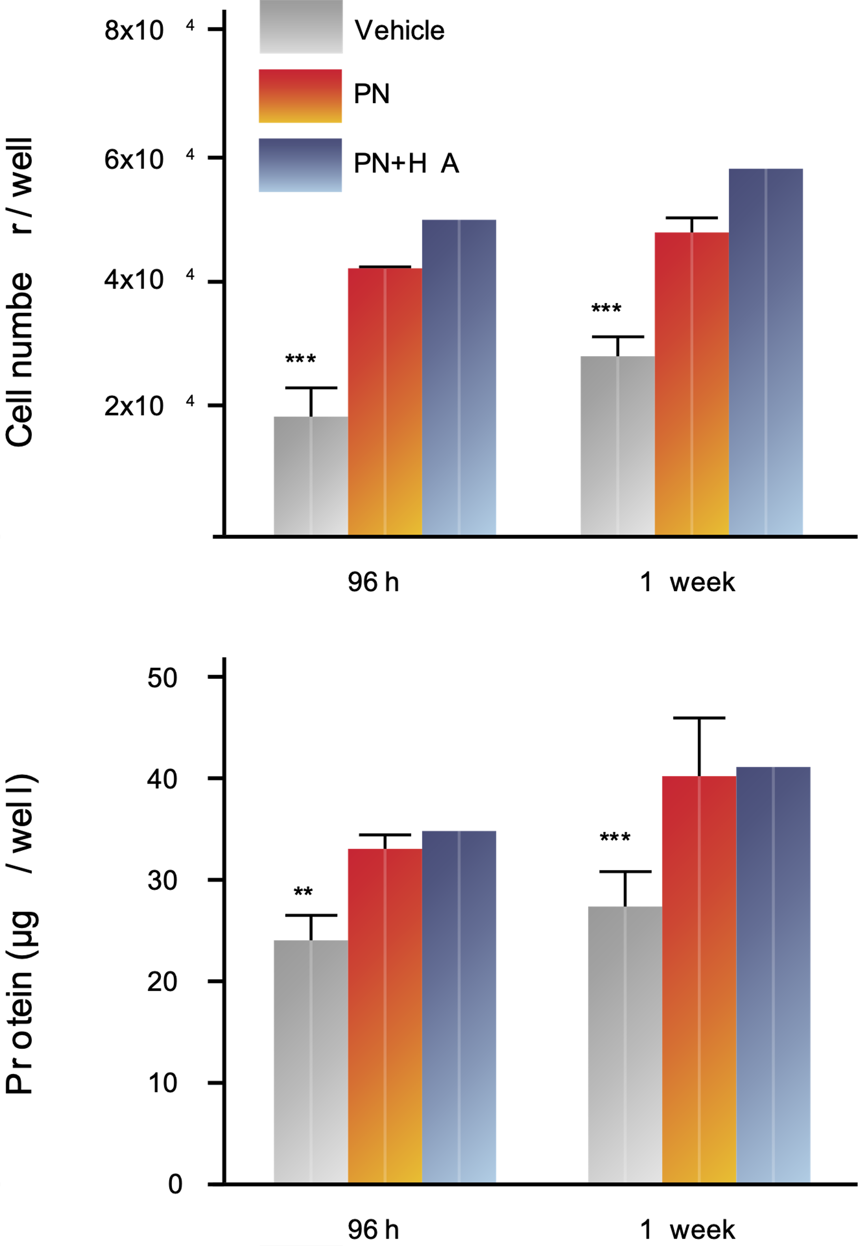
POLYNUCLEOTIDES stimulate cell proliferation and protein production¹
Increased fibroblast proliferation with PN
and PNHA¹
Protein production
PN and PNHA increased the production of protein and ECM synthesis¹
¹ Colangelo MT, Belletti S, Govoni P, Guizzardi S, Galli C. A Biomimetic Polynucleotides–Hyaluronic Acid Hydrogel Promotes Wound Healing in a Primary Gingival Fibroblast Model. Applied Sciences. 2021; 11(10):4405. https://doi.org/10.3390/app11104405
.
Strictly for internal use only.

Slide 15
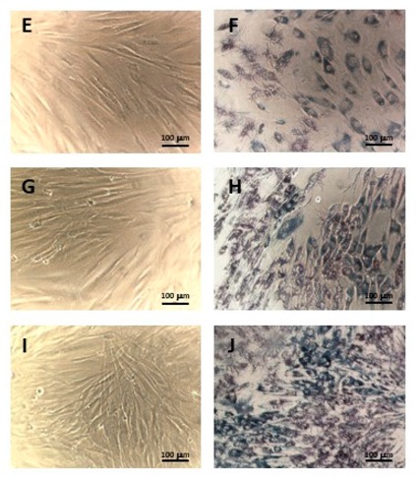
POLYNUCLEOTIDES stimulate cell vitality and cell proliferation
MTT
AFTER 1 WEEK
CONTROL
Fibroblasts – 1 week
(phase contrast microscopy).
PN
POLYNUCLEOTIDES:
Increase cell vitality¹
PN HA
¹ Colangelo MT, Belletti S, Govoni P, Guizzardi S, Galli C. A Biomimetic Polynucleotides–Hyaluronic Acid Hydrogel Promotes Wound Healing in a Primary Gingival Fibroblast Model. Applied Sciences. 2021; 11(10):4405. https://doi.org/10.3390/app11104405
Strictly for internal use only.

Slide 16
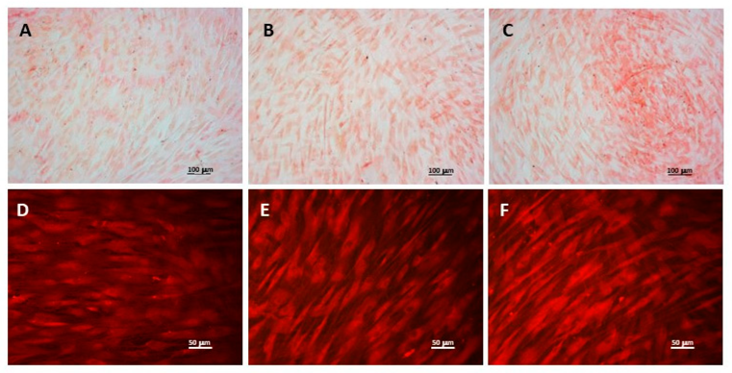
POLYNUCLEOTIDES promote extracellular matrix deposition¹
CONTROL POLYNUCLEOTIDES POLYNUCLEOTIDES + HA
Fibroblasts
STAINING WITH SIRIUS RED
WIDE FIELD MICROTOGRAPHY
RESOLUTION¹
Collagen deposition/ EXTRACELLULAR MATRIX.
Fibroblasts treated with PN+HA show higher concentration.¹
¹ Colangelo MT, Belletti S, Govoni P, Guizzardi S, Galli C. A Biomimetic Polynucleotides–Hyaluronic Acid Hydrogel Promotes Wound Healing in a Primary Gingival Fibroblast Model. Applied Sciences. 2021; 11(10):4405. https://doi.org/10.3390/app11104405.
Strictly for internal use only.

Slide 17
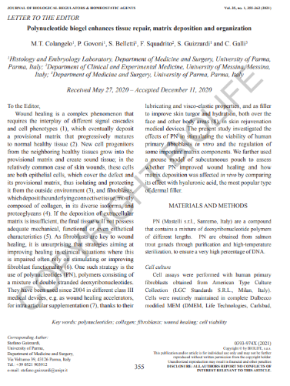
PN-HPT® enhances tissue repair, matrix disposition and organisation¹
Recent study investigated the effects of PN in stimulating viability of human primary fibroblasts in vitro and regulation of some important matrix components.¹
Study also evaluated whether PN improved wound healing and how matrix disposition was affected in vivo by comparing its effects to hyaluronic acid.¹
¹ Collangelo MT. Govoni P, Beletti s, Squadrito F, Guizzardi S, Galli C. Polynucleotide biogel enchances tissue repair, matrix desposition and organization. J. of Biological Regulators &Homeostatic Agents. 2021;Vol35(1):355-362.
Strictly for internal use only.

Slide 18

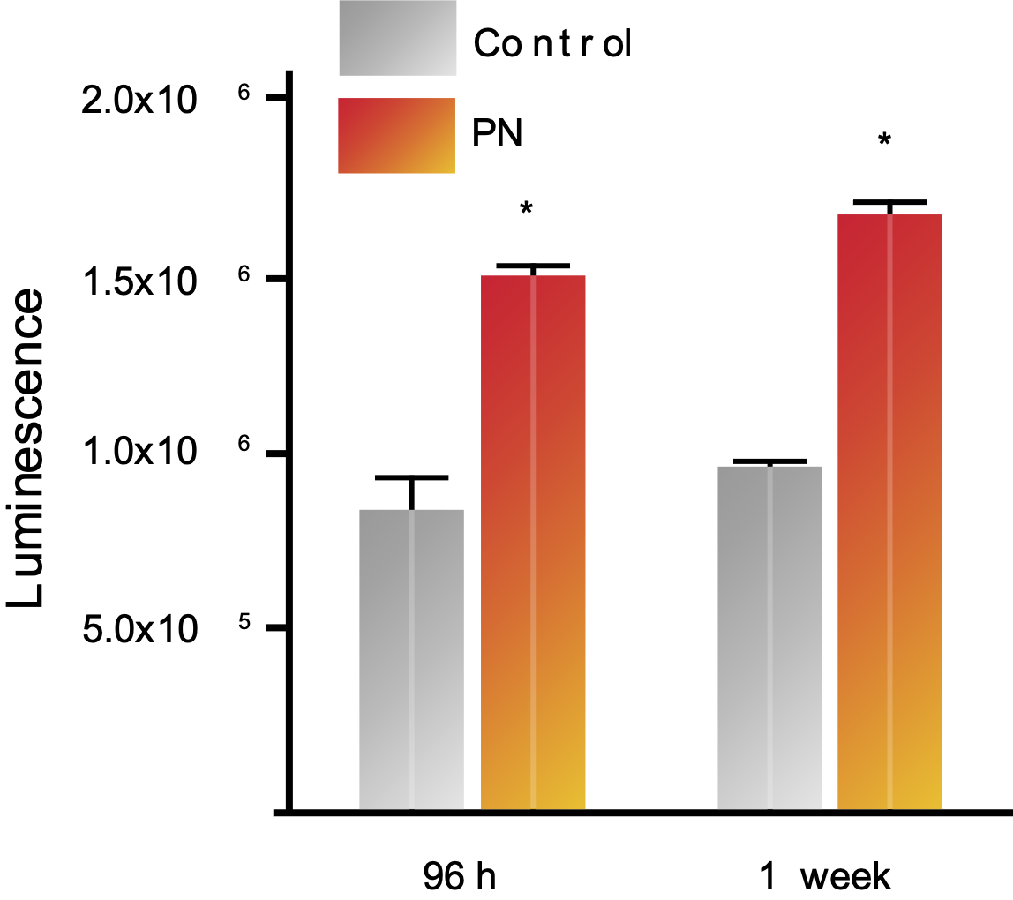
PN-HPT® increase fibroblast viability
PN promoted a trophic and stimulating action on existing fibroblasts, thus increasing their viability
Fibroblast viability levels were significantly higher in presence of PN compared with control after 96 hours and 1 week (p<0.001)
Adapted from Collangelo MT. Govoni P, Beletti s, Squadrito F, Guizzardi S, Galli C. Polynucleotide biogel enchances tissue repair, matrix desposition and organization. J. of Biological Regulators &Homeostatic Agents. 2021;Vol35(1):355-362.
*p<0.001
Strictly for internal use only.

Slide 19
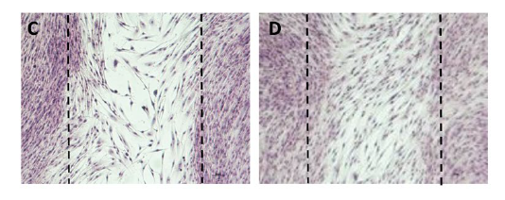
PN-HPT® enhance fibroblast proliferation
PN increase the number of human fibroblast cells in vitro scratch test
Control cells
Cells stimulated with PN
A visibly higher number of cells bridge in the scratch area stimulated with PN at 96 hours and 1 week (p<0.001)
Transmitted light micrographs of scratch test assay
Collangelo MT. Govoni P, Beletti s, Squadrito F, Guizzardi S, Galli C. Polynucleotide biogel enchances tissue repair, matrix desposition and organization. J. of Biological Regulators &Homeostatic Agents. 2021;Vol35(1):355-362.
Strictly for internal use only.

Slide 20
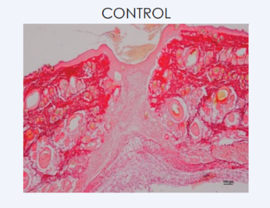
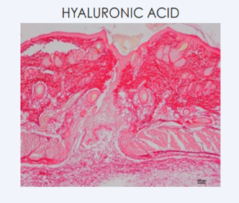
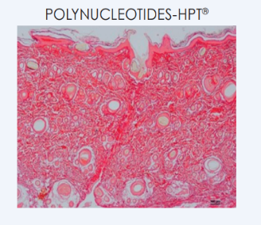
PN-HPT® enhance tissue repair better than HA alone
Control group: Tissue repair is incomplete, with a scarce presence of collagen fibres
Hyaluronic acid group: Tissue repair is not complete, with collagen fibres only partly occupying the repaired area
PN-HPT®: Tissue repair is almost complete, with mature and well organised collagen fibres and consequent uniform deposition of the extracellular matrix
Histological evaluation of tissue repair. Detections using Sirius dye and polarised light
Collangelo MT. Govoni P, Beletti s, Squadrito F, Guizzardi S, Galli C. Polynucleotide biogel enchances tissue repair, matrix desposition and organization. J. of Biological Regulators &Homeostatic Agents. 2021;Vol35(1):355-362.
Strictly for internal use only.

Slide 21
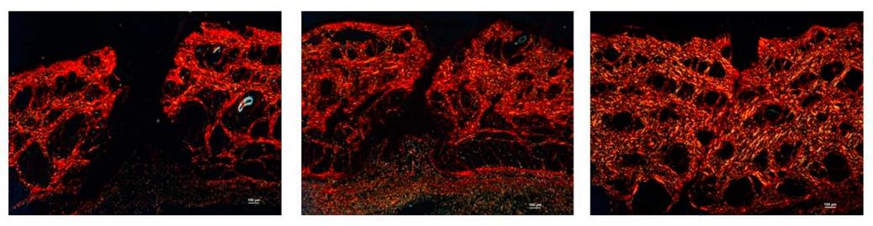
Focus on collagen fibres
CONTROL
HA
PN-HPT®
PN-HPT® promote an increased and better organization of collagen fibres compared to control and compared to treatments with HA alone.
Colangelo MT, Belletti S, Govoni P, Guizzardi S, Galli C. A Biomimetic Polynucleotides–Hyaluronic Acid Hydrogel Promotes Wound Healing in a Primary Gingival Fibroblast Model. Applied Sciences. 2021; 11(10):4405. https://doi.org/10.3390/app11104405
Strictly for internal use only.

Slide 22
Conclusions
Polynucleotides attract and bind water molecules in a stable and permanent manner forming a three-dimensional gel.
Polynucleotides undergo physiological degradation by specific enzymes (endogenous DNAses naturally present at tissues level), leading to a slow and progressive release of water molecules in situ.
Studies shows that polynucleotides promote cell/fibroblast viability both in vitro and in vivo and also the deposition of extracellular matrix ECM, improving tissue homeostasis.
PN stimulates collagen and ECM deposition
Colangelo MT, Belletti S, Govoni P, Guizzardi S, Galli C. A Biomimetic Polynucleotides–Hyaluronic Acid Hydrogel Promotes Wound Healing in a Primary Gingival Fibroblast Model. Applied Sciences. 2021; 11(10):4405. https://doi.org/10.3390/app11104405
Collangelo MT. Govoni P, Beletti s, Squadrito F, Guizzardi S, Galli C. Polynucleotide biogel enchances tissue repair, matrix desposition and organization. J. of Biological Regulators &Homeostatic Agents. 2021;Vol35(1):355-362.
Strictly for internal use only.

Slide 23
Why polynucleotides?

Slide 24
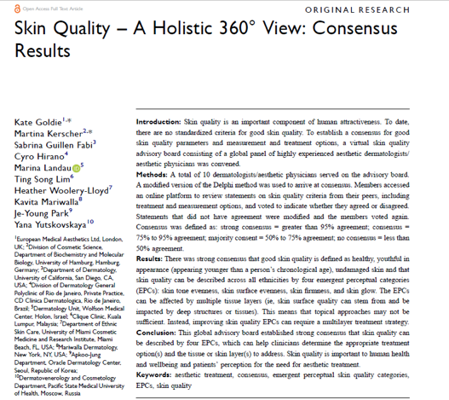

Skin Quality is equally important as other characteristics
SKIN FIRMNESS
(See and feel)
SKIN SURFACE
EVENNESS
SKIN TONE
EVENNESS
SKIN
GLOW
Cavallini M, Bartoletti E, Maioli L, Massirone A, Pia Palmieri I, Papagni M et al. Consensus report on the use of PN-HPT™ (polynucleotides highly purified technology) in aesthetic medicine. J Cosmet Dermatol. 2021 Mar;20(3):922-928. doi: 10.1111/jocd.13679. Epub 2020 Sep 21. PMID: 32799391; PMCID: PMC7984045.
Strictly for internal use only.

Slide 25
Are all the polynucleotide products the same? What makes PhilArt your choice of PN injectable?

Slide 26
Trout sourced Fish Polynucleotides (PN)
European Fish farms - Trout fish bred for human consumption (sweet water) - due to better quality control.
Fish is rigorously controlled throughout its entire life cycle: strict veterinary control, water control, food control, heavy metals contamination control.
Wild salmon extraction cannot ensure the rigorous control of the fish throughout its life cycle – pollutants in seawater can contaminate the trout(heavy metals, plastic, radioactive particles).
Strictly for internal use only.

Slide 27
Trout Fish Polynucleotides (PN)
Full control of the production chain and commercial network:
Extraction trout gonads (fish bred for human consumption)
Polynucleotide purification (GMP)
Packaged as medical devices in pre filled glass syringes
Controlled distribution (GDP)
GMP, ISO certifications
Polynucleodite Highly Purified Technology
Stricly for internal use.

Slide 28
Original extraction technology from raw material
High level of purification
Safety of use
Based on 70 years of research
Over 100 published studies- presentations in national and international congresses and medical conferences
Total control of the entire production chain
100% manufactured in the European Union
PN-HPT®
High Purification Technology
Strictly for internal use only.

Slide 29

PN-HPT®
Unique and Exclusive Technology
Developed by the manufacturer's R&D department with the support of expert consultants working in the most prestigious Italian universities
Covered by industrial secrecy
PN-HPT® High Purification Technology results in safe products.
Strictly for internal use only.

Slide 30
PhilArt PN-HPT® for skin regeneration, skin quality and skin health
PN-HPT® have both tissue hydrating and viscoelastic properties that are similar to those of hyaluronic acid
Long-term PN-HPT® prime wounded, atrophic or wrinkled tissues to improve the production of new collagen and elastin fibres and generate new dermal matrix glycosaminoglycans
Overall PN-HPT® promote fibroblast viability and increase collagen production
Bartoletti E, Cavallini M, Maioli L, Massirone A, Palmieri IP, Papagni M et al. Introduction to Polynucleotides Highly Purified Technology. Aesthetic Medicine.2020 Oct-Dec;Vol.7(1):43-47.
Strictly for internal use only.

Slide 31
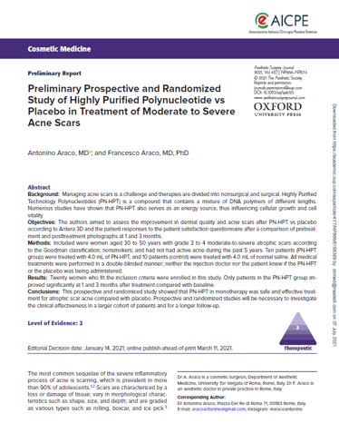
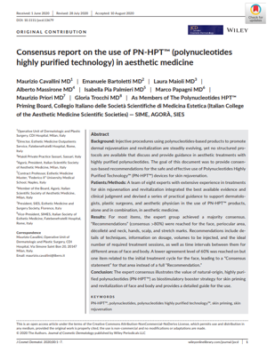
Evidence-based literature
The manufacturer has a wide number of published studies supporting the efficacy and safety of its products
81 papers published in scientific journals (from 2006 to 2021)
101 abstracts (mainly presented at Aesthetic Medicine Congresses from 2006 to 2021)
Strictly for internal use only.

Slide 32
Polynucleotides in your aesthetic practice

Slide 33
Facial assessment on how to achieve the most desired results

Slide 34




Facial assesment for the most desired result
Strictly for internal use only.
¹ Cavallini M, Papagni M. Long Chain Polynucleotides Gel and Skin Biorevitalization. International Journal of Plastic Dermatology-ISPLAD. 2007; 3(3): 27-32

Slide 35
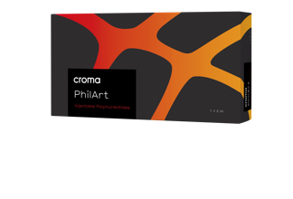
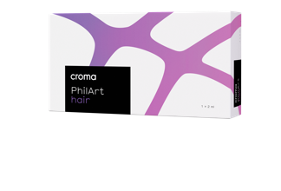
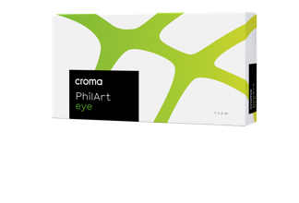

How to navigate the PhilArt portfolio?
O/F

Slide 36




PhilArt: a comprehensive portfolio
Composition:
PN-HPT® 40 mg/2 ml
Suggested applications:
Young skin – neck, forehead, hands, scars, acne scarring
Composition:
PN-HPT® 15 mg/2 ml
Suggested applications:
Hair, scalp, eyebrows
Composition:
PN-HPT® 15 mg/2 ml
Suggested applications:
Eye contour, eyelids, superficial wrinkles
Composition:
PN-HPT® 20 mg/2 ml;
hyaluronic acid 20 mg/2 ml
Suggested applications:
Mature and dehydrated skin

Slide 37


F

Slide 38

What is PhilArt?
Highly purified and reabsorbable polynucleotides (PN-HPT®)
20 mg/ml
Available in 2ml syringe
With two 30G ½ / 13 mm needle
Strictly for internal use only.

Slide 39
Where and for what PhilArt can be used?
Anatomical areas:
Face, including forehead, arches of the eyebrow, periorbital, cheekbone area.
Neck
Abdomen
Buttocks
Thighs, etc.
For:
Improving the quality of the skin in younger and more mature patients
Remodeling the areas with a high fibroses, e.g. striae and scars
Strictly for internal use only.

Slide 40

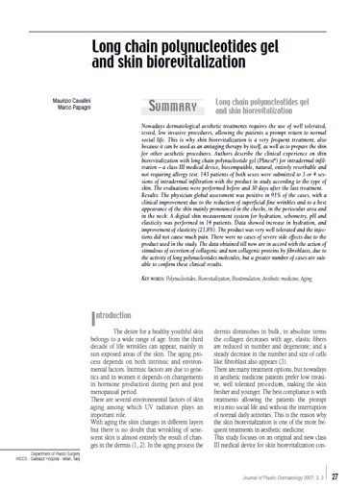
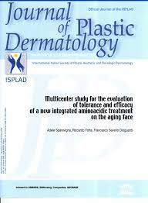
PhilArt: Long chain polynucleotides gel and skin biorevitalization – Clinical study set up
Clinical experience on skin biorevitalization with long chain polynucleotide gel has been evaluated in 143 patients between 32 and 75 years of age of both sexes before and 30 days after the last treatment using 2 protocols for face, neck decolletage and back of the hands¹:
prevention treatment, for younger skin, consisting of a 3 intradermal infiltrations treatment - one every 3 weeks - followed by a maintenance treatment every 2-3 months¹
recovery treatment, a stronger treatment for aging skin, consisting of 4 infiltrations treatment, one every 1-2 weeks, followed by maintenance sessions every 1-3 months¹
Strictly for internal use only.
O
¹ Cavallini M, Papagni M. Long Chain Polynucleotides Gel and Skin Biorevitalization. International Journal of Plastic Dermatology-ISPLAD. 2007; 3(3): 27-32

Slide 41
PhilArt: Long chain polynucleotides gel and skin biorevitalization – Clinical Study Results
The data obtained till now are in accord with the action of stimulus of secretion of collagenic and non-collagenic proteins by fibroblasts, due to the activity of long polynucleotides molecules¹
91%
patients demonstrated clinical improvement due to superficial fine wrinkles reduction and better tonic*
+14.7%
Improvement of the skin hydration vs baseline**
+21.8%
Increase of skin elasticity**
The product was very well tolerated and no cases of severe side effects.
¹ Cavallini M, Papagni M. Long Chain Polynucleotides Gel and Skin Biorevitalization. International Journal of Plastic Dermatology-ISPLAD. 2007; 3(3): 27-32
*The physician global assessment during the follow-up visit (Figure 1) was positive. In fact in 91% of the patients the physician noted a clinical improvement (73% improved and 18% highly improved), due to the reduction of superficial fine wrinkles and to a better aspect of the skin that showed to be more tonic. In particular this result was noted in the treatment of the face, above all in the check, periocular area and neck
** Patients evaluation with digital skin measurement system (Callegari Soft 5.5). Evaluations have been recorded before
(pre) and one month later the end of treatment (post).³ Increases in skin hydration were observed after 8 weeks in both areas, however, did not reach statistical significance at any point.
Strictly for internal use only.
O

Slide 42
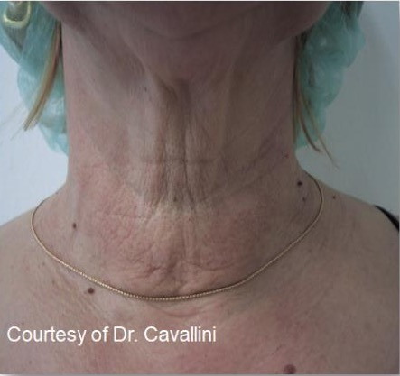
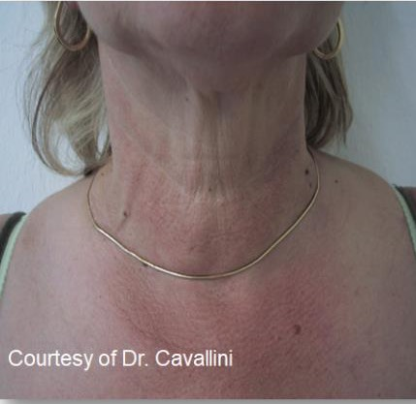
Result of application of long chain polynucleotides gel on the neck
a
b
a) Patient before neck treatment with long chain polynucleotides; b) The same patient one month after four treatments with long chain polynucleotides. A reduction of fine wrinkles, an improvement of tonicity and appearance of the skin are shown.
Strictly for internal use only.
O
¹ Cavallini M, Papagni M. Long Chain Polynucleotides Gel and Skin Biorevitalization. International Journal of Plastic Dermatology-ISPLAD. 2007; 3(3): 27-32

Slide 43
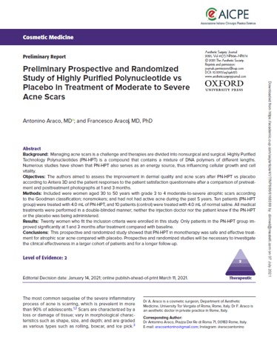
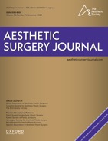
PhilArt: Efficacy of highly purified polynucleotide vs
placebo for moderate to severe acne scars treatment
Objective: Preliminary prospective and randomized study to assess the improvement in dermal quality and acne scars after PN-HPT vs placebo according to Antera 3D and the patient responses to the patient satisfaction questionnaire after a comparison of pretreatment and posttreatment photographs at 1 and 3 months.
Patients: 20 women aged 30 to 50 years with grade 3 to 4 moderate-to-severe atrophic scars according to the Goodman classification; nonsmokers; and had not had active acne during the past 5 years.
Methods: Ten patients (PN-HPT group) were treated with 4.0 mL of PN-HPT, and 10 patients (control) were treated with 4.0 mL of normal saline. All medical treatments were performed in a double-blinded manner;
Strictly for internal use only.
Araco A, Araco F. Preliminary Prospective and Randomized Study of Highly Purified Polynucleotide vs Placebo in Treatment of Moderate to Severe Acne Scars. Aesthet Surg J. 2021 Jun 14;41(7):NP866-NP874. doi: 10.1093/asj/sjab125. PMID: 33755110.
O

Slide 44
PhilArt: Efficacy of highly purified polynucleotide vs placebo for moderate to severe acne scars treatment
Our prospective and randomized study showed that PN-HPT in monotherapy was safe and effective treatment for atrophic scar acne compared with placebo
Significant improvement of the wrinkles at month 1and 3 vs baseline (p<0.05)*
Significant inprovement of skin texture at month 1and 3 vs baseline (p<0.05)
Patients were satisfied at month 3 posttreatment
No minor or major side effects were reported during
the study,
Strictly for internal use only.
Araco A, Araco F. Preliminary Prospective and Randomized Study of Highly Purified Polynucleotide vs Placebo in Treatment of Moderate to Severe Acne Scars. Aesthet Surg J. 2021 Jun 14;41(7):NP866-NP874. doi: 10.1093/asj/sjab125. PMID: 33755110.
O

Slide 45
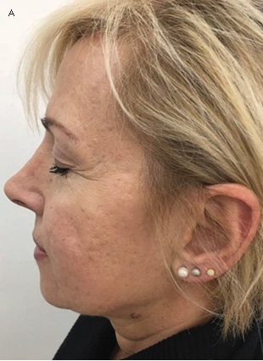
Efficacy of highly purified polynucleotide for the treatment of moderate to severe acne scars
BEFORE
CASE STUDY 1
Age
52
Prior aesthetic treatment
None
Goal
Improve appearance of acne scars
Reduce skin roughness
Image courtesy
Araco A, Araco F. Preliminary Prospective and Randomized Study of Highly Purified Polynucleotide vs Placebo in Treatment of Moderate to Severe Acne Scars. Aesthet Surg J. 2021 Jun 14;41(7):NP866-NP874. doi: 10.1093/asj/sjab125. PMID: 33755110.
Strictly for internal use only.

Slide 46
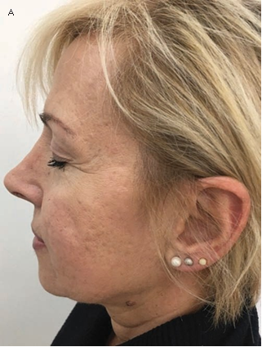
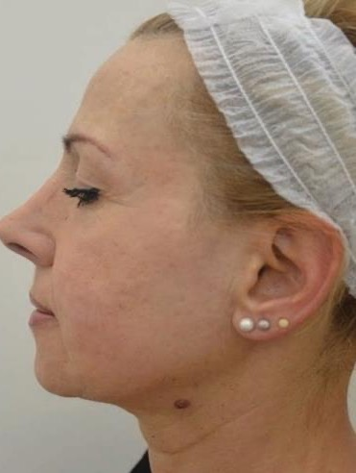
A)BEFORE
B)AFTER
6 months post-treatment
CASE STUDY 1
results
B
The patient was treated twice (at T0 and after 3 weeks) with 4.0 mL of PN-HPT®
A total quantity of
30 micro-droplets (0.1- 0.2 ml) was injected subdermically with a 30 G ½ needle.
Araco A, Araco F. Preliminary Prospective and Randomized Study of Highly Purified Polynucleotide vs Placebo in Treatment of Moderate to Severe Acne Scars. Aesthet Surg J. 2021 Jun 14;41(7):NP866-NP874. doi: 10.1093/asj/sjab125. PMID: 33755110.
Image courtesy
Strictly for internal use only.

Slide 47
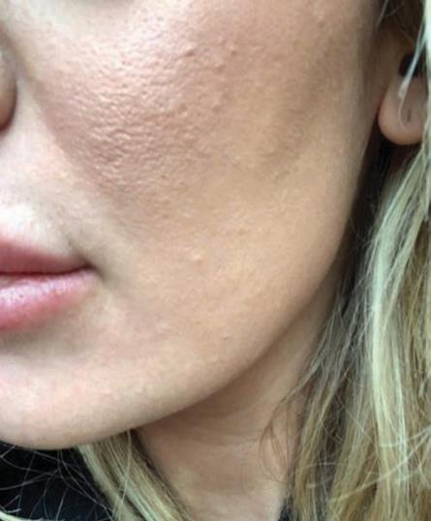
BEFORE
CASE STUDY 2
A
Age
36
Prior aesthetic treatment
None
Goal
Improve skin texture,
skin homogeneity and acne scars
Image courtesy
Araco A, Araco F. Preliminary Prospective and Randomized Study of Highly Purified Polynucleotide vs Placebo in Treatment of Moderate to Severe Acne Scars. Aesthet Surg J. 2021 Jun 14;41(7):NP866-NP874. doi: 10.1093/asj/sjab125. PMID: 33755110.
Strictly for internal use only.

Slide 48
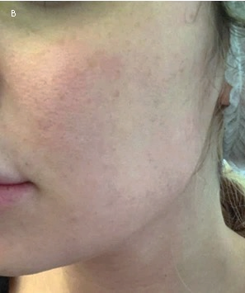
Results with PN-HPT®
BEFORE
AFTER
(30 days after last treatment)
CASE STUDY 2
A
The patient was treated twice (at T0 and after 3 weeks) with 4.0 mL of PN-HPT ®.
A total quantity of 30 micro-droplets (0.1-0.2 mL) was injected subdermically with a 30 G needle.
Image courtesy
Image courtesy
Araco A, Araco F. Preliminary Prospective and Randomized Study of Highly Purified Polynucleotide vs Placebo in Treatment of Moderate to Severe Acne Scars. Aesthet Surg J. 2021 Jun 14;41(7):NP866-NP874. doi: 10.1093/asj/sjab125. PMID: 33755110.
Strictly for internal use only.

Slide 49
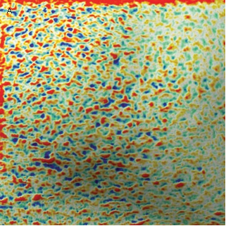
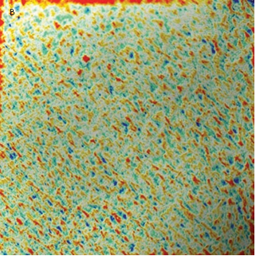
Results with PN-HPT® objectively confirmed
Significant improvement of skin texture
Araco A, Araco F. Preliminary Prospective and Randomized Study of Highly Purified Polynucleotide vs Placebo in Treatment of Moderate to Severe Acne Scars. Aesthet Surg J. 2021 Jun 14;41(7):NP866-NP874. doi: 10.1093/asj/sjab125. PMID: 33755110.
Antera 3D R®
Before
Follow-up 30 days after last injection of PN-HPT®
Strictly for internal use only.

Slide 50
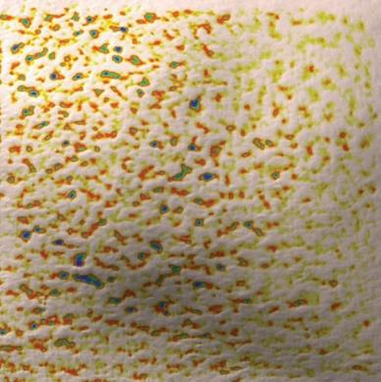
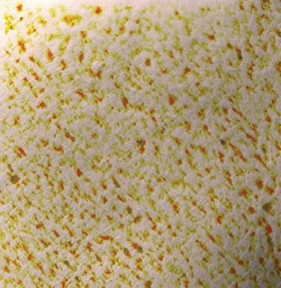
Results with PN-HPT® objectively confirmed
Significant improvement of skin texture
A
B
Araco A, Araco F. Preliminary Prospective and Randomized Study of Highly Purified Polynucleotide vs Placebo in Treatment of Moderate to Severe Acne Scars. Aesthet Surg J. 2021 Jun 14;41(7):NP866-NP874. doi: 10.1093/asj/sjab125. PMID: 33755110.
Antera 3D R®
Before
Follow-up 30 days after last injection of PN-HPT®
Strictly for internal use only.

Slide 51
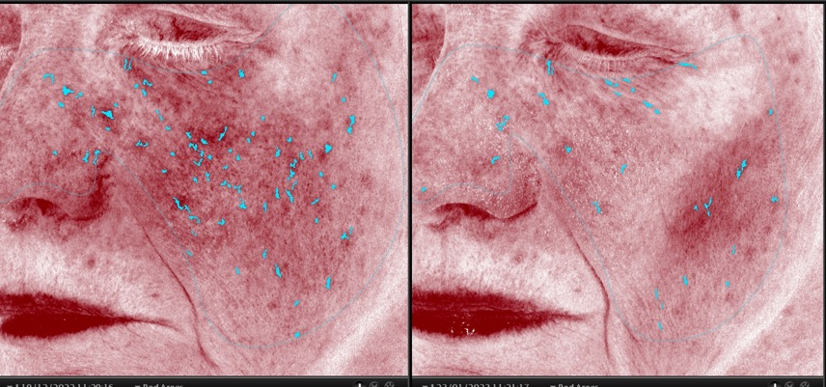
Two weeks after the second treatment
Image courtesy of prof. Syed Haq
Strictly for internal use only.

Slide 52
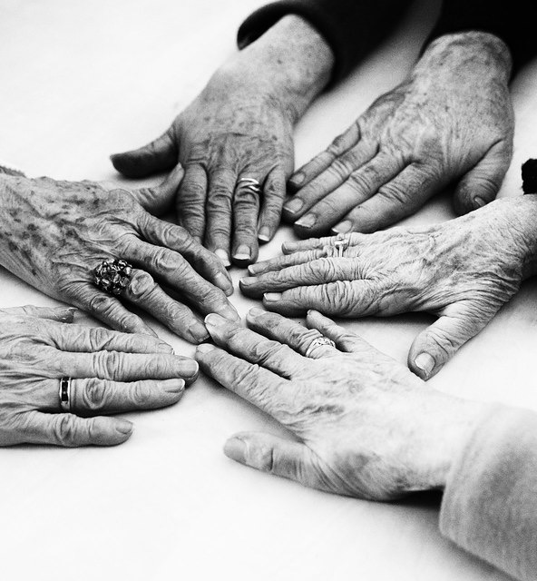
Prominent appearance of
  Dorsal veins
  Extensor tendons
  Metacarpals and phalangeal bones
Subcutaneous atrophy
Skin excess
Textural roughness
Dyschromia
Strictly for internal use only.
F

Slide 53
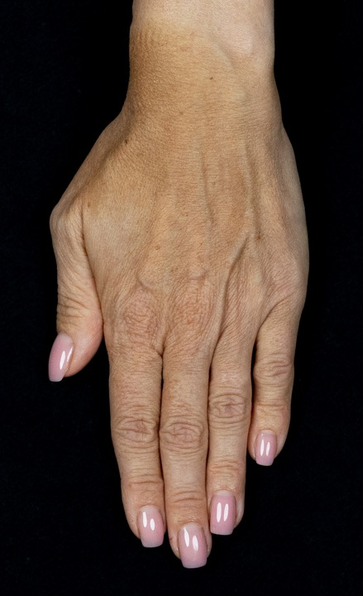
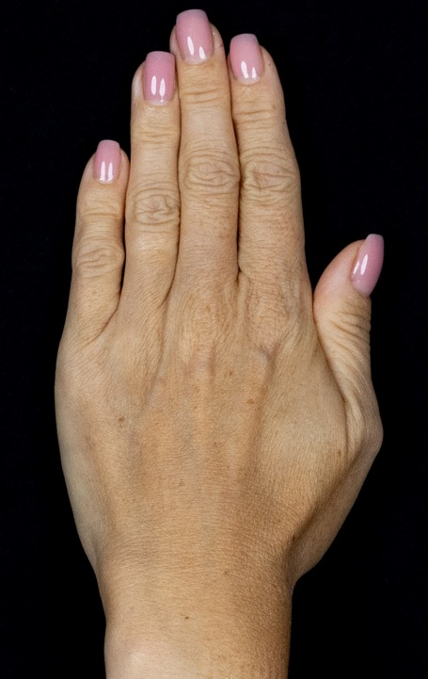
Two weeks after
4th treatment
Image courtesy of prof. Syed Haq
BEFORE
AFTER
Strictly for internal use only.
H
Notes:
What other changes we can adress with this product

Slide 54
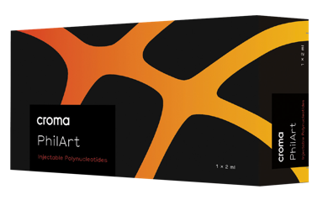
PhilArt: How to use
Depth of injection: Intradermal
Injection technique: Microdroplet, linear or fan technique
Protocol:
Every 14─21 days for 3 sessions¹
Alternative protocols used in clinical trials customized to the age of the patient:
prevention treatment, for younger skin, consisting of a
3 intradermal infiltrations treatment - one every 3 weeks - followed by a maintenance treatment every 2-3 months¹
recovery treatment, a stronger treatment for aging skin, consisting of 4 infiltrations treatment, one every
1-2 weeks, followed by maintenance sessions every
1-3 months¹
¹Cavallini M, Bartoletti E, Maioli L, et al. Consensus report on the use of PN-HPT™ (polynucleotides highly purified technology) in aesthetic medicine. J Cosmet Dermatol. 2020;00:1–7. https://doi. org/10.1111/jocd.13679
² Araco A, Araco F. Preliminary Prospective and Randomized Study of Highly Purified Polynucleotide vs Placebo in Treatment of Moderate to Severe Acne Scars. Aesthet Surg J. 2021 Jun 14;41(7):NP866-NP874. doi: 10.1093/asj/sjab125. PMID: 33755110.
Strictly for internal use only.
Notes:
Interactive. Discussion about experience / application techniques

Slide 55


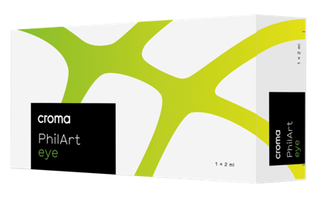
F
Notes:
Why would we need to use a specific eye product…….

Slide 56

What is PhilArt eye?
Highly purified and reabsorbable polynucleotides (PN-HPT ®)
7,5 mg/ml
Available in 2 ml syringe
With two 30G ½ needles
Strictly for internal use only.

Slide 57
Where and for what PhilArt eye can be used?
Anatomical areas:
Arches of the eyebrow
Eye contour area
Sensitive skin and delicate areas¹
For:
Improving the quality of the skin in younger and more mature patients through moisturization, facilitated trophism, improving turgidity, tonicity and suppleness.
Remodeling of the areas with high fibrous content (striae and scars)
¹ Cavallini M, Bartoletti E, Maioli L, Massirone A, Pia Palmieri I, Papagni M et al. Consensus report on the use of PN-HPT™ (polynucleotides highly purified technology) in aesthetic medicine. J Cosmet Dermatol. 2021 Mar;20(3):922-928. doi: 10.1111/jocd.13679. Epub 2020 Sep 21. PMID: 32799391; PMCID: PMC7984045.
Strictly for internal use only.

Slide 58
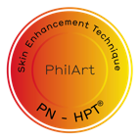
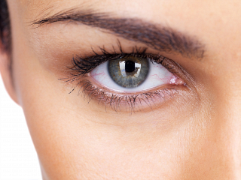
PhilArt eye: PN-HPT ® for the biostimulation of the periocular region
The eye contour is an extremely delicate area of the face
It is continuously subjected to:
  Environmental stress (wind, humidity, sudden changes in heat / cold, etc.)
  Natural movements due to facial expressions
The eye contour tends to age much more rapidly than other skin areas
Strictly for internal use only.

Slide 59
Eye contour characteristics:
The eye contour has several characteristics:
  The skin surrounding the eyes is evidently thin (0.3 mm)
  The number of hair follicles, sebaceous glands and sweat glands is much lower
  The elastic and collagen fibres present in the dermis matrix are numerically few
  Less quantity of subcutaneous fat
  The lymphatic / blood circulation of the eye contour area is slowed down
Strictly for internal use only.

Slide 60
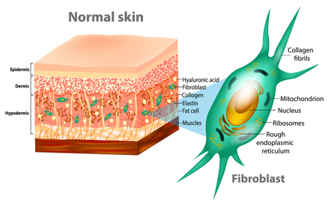
Treatments of eye area
The main treatment strategies are:
Anti wrinkle
Laser
Plasma (Thermal) energy resurfacing
Fillers (cross-linked HA only in selected cases; most suitable for treating in temporal region)
Cosmetic Surgery – Blepharoplasty
Skin Bio revitalization– Skin Rejuvenation
Induction of an effective stimulation action on fibroblast growth and activity
The use of PN-HPT ® fits into this context
Strictly for internal use only.

Slide 61
PhilArt eye – features
Actions
IMPROVEMENT OF SKIN ELASTICITY
REDUCTION OF SURFACE ROUGHNESS
REJUVENATION OF THE PERIOCULAR AREA
PREPARATION OF THE PERIOCULAR SKIN:
Before anti wrinkle treatment
Before and after cosmetic surgery (i.e. Blepharoplasty)
Before and after Laser/Plasma (Thermal) energy resurfacing
Strictly for internal use only.

Slide 62
PhilArt eye – How to use
Depth of injection: Intradermal
Injection technique: Microdroplet /Retrograde linear technique
Protocol:
One session every 14 or 21 days for a
total of 3-4 sessions¹
¹ Cavallini M, Bartoletti E, Maioli L, Massirone A, Pia Palmieri I, Papagni M et al. Consensus report on the use of PN-HPT™ (polynucleotides highly purified technology) in aesthetic medicine. J Cosmet Dermatol. 2021 Mar;20(3):922-928. doi: 10.1111/jocd.13679. Epub 2020 Sep 21. PMID: 32799391; PMCID: PMC7984045.
Strictly for internal use only.

Slide 63
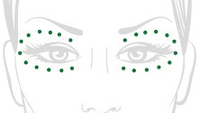
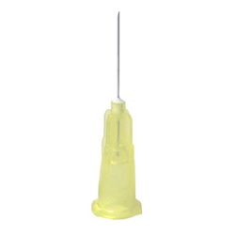
Microdroplet: Elective technique for infiltration of PN-HPT ®
PhilArt eye
Strictly for internal use only.

Slide 64
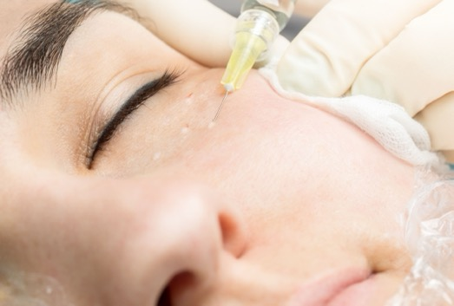
Microdroplet technique: where to inject
PhilArt eye
Strictly for internal use only.

Slide 65
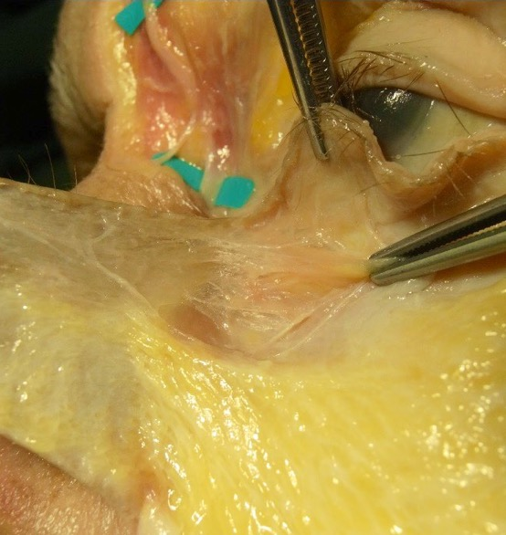
Infraorbital
Strictly for internal use only.
F

Slide 66
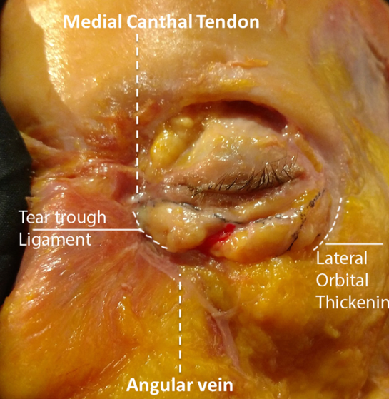
Infraorbital
Strictly for internal use only.
F

Slide 67

Clinical studies
Poster AMWC.
2016
Strictly for internal use only.

Slide 68
Clinical data behind application of the long chain PN in periorbital area
Poster AMWC.
2018
Cavallini M, Papagini M. Aesthetic & Anti-Aging Medicine World Congress, Monte Carlo 2018.
Strictly for internal use only.

Slide 69


Results with PN-HPT®
Before
After 30 days of follow-up with PN-HPT®
Antera® 3D R photos
Cavallini M, Papagini M. Aesthetic & Anti-Aging Medicine World Congress, Monte Carlo 2018.
Strictly for internal use only.

Slide 70


Results with PN-HPT®
Before
After 30 days of follow-up with PN-HPT®
Antera® 3D R photos
Cavallini M, Papagini M. Aesthetic & Anti-Aging Medicine World Congress, Monte Carlo 2018.
Strictly for internal use only.

Slide 71


Results with PN-HPT®
Before
After 30 days of follow-up with PN-HPT®
Antera® 3D R photos
Cavallini M, Papagini M. Aesthetic & Anti-Aging Medicine World Congress, Monte Carlo 2018.
Strictly for internal use only.

Slide 72


Results with PN-HPT®
Before
After 30 days of follow-up with PN-HPT®
Antera® 3D R photos
Cavallini M, Papagini M. Aesthetic & Anti-Aging Medicine World Congress, Monte Carlo 2018.
Strictly for internal use only.

Slide 73

Image courtesy of prof. Syed Haq
Before
After - 2 weeks after 2nd session
Strictly for internal use only.

Slide 74



O

Slide 75

What is PhilArt hair?
Highly purified and reabsorbable polynucleotides (PN-HPT ®)
7,5 mg/ml
Available in 2 ml syringe
With two 30G ½ needles
Strictly for internal use only.

Slide 76
Where and for what
PhilArt hair can be used?
Anatomical areas:
Scalp
Sensitive skin and delicate areas
Hair, eyebrows
For:
Moisturisation, facilitated trophism, improving turgidity, tonicity and suppleness
Proven usage also in hair loss and thinning, eyebrows thinning, before and after hair restoration surgery)¹
Strictly for internal use only.
1. Gianfaldoni R, Gianfaldoni S, Nannipieri A, Lotti T. A polynucleotide–based product to treat female hormonal hair loss. Prime July/August 2014; 4(5): 30-36

Slide 77

Fibroblasts and scalp
Fibroblastic paracrine factors are involved in signals that lead to the birth and regrowth of new hair follicles
The functional deterioration of fibroblasts compromises the health and correct physiology of the scalp
Adequate stimulation of the fibroblasts is therefore crucial for the dynamics of follicular regeneration
Strictly for internal use only.
O

Slide 78




PhilArt hair – methods of use
Thorough disinfection of the area to be treated
Technique with microdroplet spaced 0.5-2cm apart
Depth of injection: dermis
Treatment areas: scalp and eyebrows
No hair washing after treatment
within the next 12 hours
Strictly for internal use only.
O

Slide 79


Patient selection
University of Pisa - Dermatology Unit
20 women with female with hormonal hair loss
Age between 25 and 65 years
Patients not suffering from systemic diseases (iron deficiency, febrile diseases, endocrinopathies, liver diseases, etc.)
No current or recent psycho-physical stress
No weight loss diets, drug therapy, contraceptive pills
Strictly for internal use only.
Gianfaldoni R, Gianfaldoni S, Nannipieri A, Lotti T. A polynucleotide–based product to treat female hormonal hair loss. Prime July/August 2014; 4(5): 30-36
O

Slide 80
PhilArt hair: How to use
Depth of injection: Intradermal
Injection technique:
Microdroplet technique with intradermal infiltrations of 0.2 ml for each droplet
Protocol:¹
Initial treatment cycle: one session every 7 or 14 days for a total of 4 sessions.
Followed by one session every 21 days for a total of 4 sessions.
¹ Cavallini M, Bartoletti E, Maioli L, Massirone A, Pia Palmieri I, Papagni M et al. Consensus report on the use of PN-HPT™ (polynucleotides highly purified technology) in aesthetic medicine. J Cosmet Dermatol. 2021 Mar;20(3):922-928. doi: 10.1111/jocd.13679. Epub 2020 Sep 21. PMID: 32799391; PMCID: PMC7984045.
Strictly for internal use only.

Slide 81



Method of administration and treatment scheme
PhilArt PN-HPT® administered with 2 ml pre-filled syringe containing 15 mg of PhilArt PN-HPT®
Microdroplet technique with intradermal infiltrations of 0,2 ml for each drop
First month: one per week for 4 weeks
Second, 3rd and 4th month: infiltration every 2-3 weeks
Clinical evaluation T0, T1, T2, T4 months
Gianfaldoni R, Gianfaldoni S, Nannipieri A, Lotti T. A polynucleotide–based product to treat female hormonal hair loss. Prime July/August 2014; 4(5): 30-36
Strictly for internal use only.
O

Slide 82


Results: Pull Test
Results of the pull test at the start of treatment (T0) and after 1 month, 2 months and 4 months with evident reduction in the number of hair lost following the pull test
Gianfaldoni R, Gianfaldoni S, Nannipieri A, Lotti T. A polynucleotide–based product to treat female hormonal hair loss. Prime July/August 2014; 4(5): 30-36
Strictly for internal use only.
O

Slide 83


Results: Wash Test
Results of the wash test at the beginning of the treatment and after 1 month, 2 months and 4 months with reduction of hair loss
Gianfaldoni R, Gianfaldoni S, Nannipieri A, Lotti T. A polynucleotide–based product to treat female hormonal hair loss. Prime July/August 2014; 4(5): 30-36
Strictly for internal use only.
O

Slide 84


Results: Trichogram
Restored the normal values ​​of the trichogram with hair increase in Anagen and hair reduction in Telogen
Gianfaldoni R, Gianfaldoni S, Nannipieri A, Lotti T. A polynucleotide–based product to treat female hormonal hair loss. Prime July/August 2014; 4(5): 30-36
Strictly for internal use only.
O

Slide 85

Results: Anagen / Telogen ratio
Anagen / Telogen ratio from trichogram evaluation at start of treatment (T0) and after 1 month, 2 months and 4 months with increased hair growth
Gianfaldoni R, Gianfaldoni S, Nannipieri A, Lotti T. A polynucleotide–based product to treat female hormonal hair loss. Prime July/August 2014; 4(5): 30-36
Strictly for internal use only.
O

Slide 86


Results: Videodermatoscopy
Average number of hairs in a standard area before and after treatment (T0 vs 4 months) with an increase in the number of hairs
PRE TREATMENT
POST TREATMENT
105 hairs/cm²
118 hairs/cm²
Gianfaldoni R, Gianfaldoni S, Nannipieri A, Lotti T. A polynucleotide–based product to treat female hormonal hair loss. Prime July/August 2014; 4(5): 30-36
Strictly for internal use only.
O

Slide 87


Results: Epiluminescence
Evaluation of ultrastructure in epiluminescence and dimensions
Increased hair diameter
PRE TREATMENT
POST TREATMENT
average diameter 60 um
average diameter 90 um
Gianfaldoni R, Gianfaldoni S, Nannipieri A, Lotti T. A polynucleotide–based product to treat female hormonal hair loss. Prime July/August 2014; 4(5): 30-36
Strictly for internal use only.
O

Slide 88


Results: Photographic documentation
Clinical results before (T0) and after 4 months of treatment
PRE TREATMENT
POST TREATMENT
average diameter 60 um
average diameter 90 um
Gianfaldoni R, Gianfaldoni S, Nannipieri A, Lotti T. A polynucleotide–based product to treat female hormonal hair loss.
Prime July/August 2014; 4(5): 30-36
Strictly for internal use only.
O

Slide 89

Conclusions of the Study
Increase in hair growth
Evident reduction in hair loss
improvement of hair clinical appearance in 72% of patients
No side effects
High patient compliance and satisfaction
Gianfaldoni R, Gianfaldoni S, Nannipieri A, Lotti T. A polynucleotide–based product to treat female hormonal hair loss. Prime July/August 2014; 4(5): 30-36
Strictly for internal use only.
O

Slide 90

Clinical studies
As supported by the previously illustrated clinical data, PhilArt PN-HPT® are ideally administered by intradermal infiltrations with the serial puncture technique.
Available clinical data support an ideal treatment protocol of 8-10 infiltration sessions distributed over a 4-month period: one session per week for the first 4 weeks, followed by one session every 2-3 weeks for 3 months.
Strictly for internal use only.
O

Slide 91




Slide 92

What is PhilArt next ?
Original association of:
  highly purified and reabsorbable polynucleotides (PN-HPT®) 10 mg/ml
  non-crosslinked hyaluronic acid 10mg/ml
  mannitol
Available in 2 ml syringe
Two 30G ½ 13 mm needles
Strictly for internal use only.

Slide 93
Where and for what can
PhilArt Next be used?
Anatomical areas:
Face
Neck
Abdomen
Buttocks
Thighs, etc.
For:
Improving the quality of the skin in younger and more mature patients through moisturisation, facilitated trophism, improving turgidity, and suppleness.
Remodeling striae distensae (stretch marks) the depressed scars
Strictly for internal use only.

Slide 94
PhilArt Next – How to use
Depth of injection: Intradermal
Injection technique: Different injection techniques, e.g. linear, serial puncture,
cross-linked, fan or combination of techniques
Protocol:
One session every 14 or 21 days for a total of 3 sessions
Cavallini M, Bartoletti E, Maioli L, Massirone A, Pia Palmieri I, Papagni M et al. Consensus report on the use of PN-HPT™ (polynucleotides highly purified technology) in aesthetic medicine. J Cosmet Dermatol. 2021 Mar;20(3):922-928. doi: 10.1111/jocd.13679. Epub 2020 Sep 21. PMID: 32799391; PMCID: PMC7984045.
Strictly for internal use only.

Slide 95


Mannitol to reinforce the effect of HA
Strong hydration: Mannitol is a hygroscopic agent that extends the effect of HA
Antioxidant activity
Increase of collagen
Strictly for internal use only.

Slide 96

Mannitol to reinforce the effect of HA
MANNITOL PREVENTS THE HA DEGRADATION and PROLONGS THE HA ACTIVITY
% of inibition
MANNITOL REDUCES THE DEGRADATION OF HA BY 34%
Mendoza G, Alvarez AI, Pulido MM, Molina AJ, Merino G, Real R et al. Inhibitory effects of different antioxidants on hyaluronan depolymerization. Carbohydr Res. 2007 Jan 15;342(1):96-102. doi: 10.1016/j.carres.2006.10.027. Epub 2006 Nov 2. PMID: 17123492.
Strictly for internal use only.

Slide 97

Clinical data behind PhilArt Next and PhilArt
JOURNAL OF COSMETIC DERMATOLOGY
2021
40 PATIENTS
Cavallini M, De Luca C, Prussia G, Raichi M. PN-HPT® (Polynucleotides Highly Purified Technology) in facial middle third rejuvenation. Exploring the potential. J Cosmet Dermatol. 2022 Feb;21(2):615-624. doi: 10.1111/jocd.14578. Epub 2021 Nov 17. PMID: 34791770; PMCID: PMC9299481.
Strictly for internal use only.

Slide 98

CASE STUDY
BEFORE
Age
>70
Prior aesthetic treatment
None
Goal
Reduction of nasolabial wrinkles and cheek rhytides
Restore fullness and firmness of soft tissues in malar area
Image courtesy
Cavallini M, De Luca C, Prussia G, Raichi M. PN-HPT® (Polynucleotides Highly Purified Technology) in facial middle third rejuvenation. Exploring the potential. J Cosmet Dermatol. 2022 Feb;21(2):615-624. doi: 10.1111/jocd.14578. Epub 2021 Nov 17. PMID: 34791770; PMCID: PMC9299481.
Strictly for internal use only.

Slide 99
Treatment with PN-HPT® + HA
BEFORE
CASE STUDY
Sequential treatment:
Combination of PN-HPT® plus Hyaluronic Acid, with replenishing and rapid hydrating action, which synergizes the biorevitalizing effect of PN-HPT®.
After 3 weeks administration of PN-HPT® alone
A second injection of PN-HPT®+ HA after three more weeks
Image courtesy
Cavallini M, De Luca C, Prussia G, Raichi M. PN-HPT® (Polynucleotides Highly Purified Technology) in facial middle third rejuvenation. Exploring the potential. J Cosmet Dermatol. 2022 Feb;21(2):615-624. doi: 10.1111/jocd.14578. Epub 2021 Nov 17. PMID: 34791770; PMCID: PMC9299481.
Strictly for internal use only.

Slide 100

Results with
PN-HPT® + HA
BEFORE
BEFORE
AFTER
CASE STUDY
Image courtesy
Image courtesy
6-8 weeks after last treatment session
Cavallini M, De Luca C, Prussia G, Raichi M. PN-HPT® (Polynucleotides Highly Purified Technology) in facial middle third rejuvenation. Exploring the potential. J Cosmet Dermatol. 2022 Feb;21(2):615-624. doi: 10.1111/jocd.14578. Epub 2021 Nov 17. PMID: 34791770; PMCID: PMC9299481.
Strictly for internal use only.

Slide 101

Patient treated by Dr. Carmen De Luca
Before
After
After
Image courtesy
Cavallini M, De Luca C, Prussia G, Raichi M. PN-HPT® (Polynucleotides Highly Purified Technology) in facial middle third rejuvenation. Exploring the potential. J Cosmet Dermatol. 2022 Feb;21(2):615-624. doi: 10.1111/jocd.14578. Epub 2021 Nov 17. PMID: 34791770; PMCID: PMC9299481.
Strictly for internal use only.

Slide 102

Conclusions
Significant improvement of overall skin quality and texture.
Significant improvement of wrinkles and skin roughness, elasticity and pigmentation.
Excellent results in individual satisfaction score at the end of treatment.
PN-HPT® & PN-HPT® + HA candidate as a valuable option for facial middle third rejuvenation.
Cavallini M, De Luca C, Prussia G, Raichi M. PN-HPT® (Polynucleotides Highly Purified Technology) in facial middle third rejuvenation. Exploring the potential. J Cosmet Dermatol. 2022 Feb;21(2):615-624. doi: 10.1111/jocd.14578. Epub 2021 Nov 17. PMID: 34791770; PMCID: PMC9299481.
Strictly for internal use only.

Slide 103
Treatment protocols based on consensus report

Slide 104

CONSENSUS REPORT PN-HPT®
PN- HPT®
Background Need and objective
Cavallini M, Bartoletti E, Maioli L, Massirone A, Pia Palmieri I, Papagni M et al. Consensus report on the use of PN-HPT™ (polynucleotides highly purified technology) in aesthetic medicine. J Cosmet Dermatol. 2021 Mar;20(3):922-928. doi: 10.1111/jocd.13679. Epub 2020 Sep 21. PMID: 32799391; PMCID: PMC7984045.
Strictly for internal use only.

Slide 105


Consensus report on use of
PN-HPT® in aesthetic medicine
Main strength of PN-HPT® is their reactivating efficacy on mesenchymal cells with special reference to dermal fibroblasts
Expert consensus illustrates the value of PN-HPT® as a biostimulatory booster strategy for skin enhancement and revitalization of face and body
PN-HPT® act as background preparation of tissues, before other treatments, to reach globally aesthetic outcomes
Cavallini M, Bartoletti E, Maioli L, Massirone A, Pia Palmieri I, Papagni M et al. Consensus report on the use of PN-HPT™ (polynucleotides highly purified technology) in aesthetic medicine. J Cosmet Dermatol. 2021 Mar;20(3):922-928. doi: 10.1111/jocd.13679. Epub 2020 Sep 21. PMID: 32799391; PMCID: PMC7984045.
Strictly for internal use only.

Slide 106
CONSENSUS REPORT PN-HPT®
PN- HPT®
Background Need and objective
BACKGROUND:
Injective procedures using HIGHLY PURIFIED TECHNOLOGY POLYNUCLEOTIDES-BASED PRODUCTS in aesthetic medicine are steadily evolving, yet no structured protocols were available to provide guidance in aesthetic treatments
OBJECTIVE:
To reach a CONSENSUS RECOMMENDATIONS FOR A SAFE AND EFFECTIVE USE OF PN- HPT® DEVICES IN SKIN REJUVENATION
Cavallini M, Bartoletti E, Maioli L, Massirone A, Pia Palmieri I, Papagni M et al. Consensus report on the use of PN-HPT™ (polynucleotides highly purified technology) in aesthetic medicine. J Cosmet Dermatol. 2021 Mar;20(3):922-928. doi: 10.1111/jocd.13679. Epub 2020 Sep 21. PMID: 32799391; PMCID: PMC7984045.
Strictly for internal use only.

Slide 107



Maurizio Cavallini
Expert Panel Coordinator, Operative Unit of Dermatologic and Plastic Surgery, CDI Hospital, Milano, Italia
Emanuele Bartoletti
President of Italian Society of Esthetic Medicine– SIME (Roma)
Director of Esthetic Medicine Outpatients Service, Fatebenefratelli Hospital, Roma, Italia
Laura Maioli
Private Practice Sassari, Sassari, Italia
Alberto Massirone
President of Italian Scientific Society of Aesthetic Medicine- AGORA’ (Milano)
CONSENSUS REPORT
PhilArt PN-HPT®
Polynucleotide-High Purification Technology®
Background Need and objective
Isabella Pia Palmieri
Contract Professor, Esthetic Medicine Master, “Federico II” University Medical School, Napoli, Italia
Marco Papagni
Member of Agorà, Italian Scientific Society of Aesthetic Medicine- AGORA’ (Milano)
Maurizio Priori
President of Esthetic Medicine and Surgery Society - SIES (Firenze, Italia)
Gloria Trocchi
Vice-President, of Italian Society of Esthetic Medicine– SIME (Roma), Fatebenefratelli Hospital, Roma, Italia
Eight expert in Dermatology, Plastic Surgery and Aesthetic Medicine with extensive experience in skin rejuvenation treatments reviewed the published literature and integrated it with their clinical experience.
Cavallini M, Bartoletti E, Maioli L, Massirone A, Pia Palmieri I, Papagni M et al. Consensus report on the use of PN-HPT™ (polynucleotides highly purified technology) in aesthetic medicine. J Cosmet Dermatol. 2021 Mar;20(3):922-928. doi: 10.1111/jocd.13679. Epub 2020 Sep 21. PMID: 32799391; PMCID: PMC7984045.
Strictly for internal use only.
H

Slide 108



CONSENSUS REPORT PN-HPT®
PN-HPT®
Background Need and objective
The Consensus Report on the use of PN- HPT® in aesthetic medicine is the outcome of the partnership within the three Italian Society of Aesthetic Medicine which settled in to the Italian College of the Aesthetic Medicine Scientific Societies – Priming Board
AGORA’
SIES
SIME
Cavallini M, Bartoletti E, Maioli L, Massirone A, Pia Palmieri I, Papagni M et al. Consensus report on the use of PN-HPT™ (polynucleotides highly purified technology) in aesthetic medicine. J Cosmet Dermatol. 2021 Mar;20(3):922-928. doi: 10.1111/jocd.13679. Epub 2020 Sep 21. PMID: 32799391; PMCID: PMC7984045.
Strictly for internal use only.

Slide 109
Goals of the PN-HPT®-based treatment
PN-HPT®
Areas of teatment | Face Neck Décolleté | Body Back of the hands | Scalp Eyebrow Beard
Aim | Skin Rejuvenation Hydration Scar improvement | Skin Rejuvenation Hydration Scar improvement Stretch mark improvement | Normalization of follicular activity Hair growth
Cavallini M, Bartoletti E, Maioli L, Massirone A, Pia Palmieri I, Papagni M et al. Consensus report on the use of PN-HPT™ (polynucleotides highly purified technology) in aesthetic medicine. J Cosmet Dermatol. 2021 Mar;20(3):922-928. doi: 10.1111/jocd.13679. Epub 2020 Sep 21. PMID: 32799391; PMCID: PMC7984045.
Strictly for internal use only.

Slide 110
Benefits of PN-HPT® based skin treatment
PN-HPT™ | BENEFITS | OTHER TREATMENTS
Combination approach | Improvement of tissue turgor and skin trophism | Hyaluronic acid (HA)
Skin enhancement | Valid preparation of skin before a second different aesthetic treatment | CO2 Laser Energy and light Devices HA Fillers Peeling Needling Surgery
Cavallini M, Bartoletti E, Maioli L, Massirone A, Pia Palmieri I, Papagni M et al. Consensus report on the use of PN-HPT™ (polynucleotides highly purified technology) in aesthetic medicine. J Cosmet Dermatol. 2021 Mar;20(3):922-928. doi: 10.1111/jocd.13679. Epub 2020 Sep 21. PMID: 32799391; PMCID: PMC7984045.
Strictly for internal use only.

Slide 111
Intradermal injecting procedure of PN-HPT®-based devices
PN-HPT®
Injection Technique needle | Micro droplet (Serial puncture ) Linear retrograde
Skin layer | Intra dermal
Needle | 30 Gauge ½ (13 mm, in the box)
Microdroplet technique can reach the dermal layer with very high precision.
push the needle and plunger slowly until a small white bleb appears
in the skin.
Cavallini M, Bartoletti E, Maioli L, Massirone A, Pia Palmieri I, Papagni M et al. Consensus report on the use of PN-HPT™ (polynucleotides highly purified technology) in aesthetic medicine. J Cosmet Dermatol. 2021 Mar;20(3):922-928. doi: 10.1111/jocd.13679. Epub 2020 Sep 21. PMID: 32799391; PMCID: PMC7984045.
Strictly for internal use only.

Slide 112
Treatment protocols skin enhancement and revitalization of face with PN-HPT®
Face treatment | PN-HPT™ 40mg/2ml (e.g. PhilArt) | PN-HPT™+HA 40mg/2ml (e.g. PhilArt next) | PN-HPT™ 15mg/2ml (e.g. PhilArt eye) | ml at each session | Treatment protocol
Normal skin | x | x |  | 2 ml | One session every 14 or 21 days for a total of 3 sessions
Advanced skin ageing | x | x |  | 2 ml | One session every 14 or 21 days for a total of 4 sessions
Sensitive skin and delicate areas |  |  | x | 2 ml | One session every 14 or 21 days for a total of 3 sessions
Cavallini M, Bartoletti E, Maioli L, Massirone A, Pia Palmieri I, Papagni M et al. Consensus report on the use of PN-HPT™ (polynucleotides highly purified technology) in aesthetic medicine. J Cosmet Dermatol. 2021 Mar;20(3):922-928. doi: 10.1111/jocd.13679. Epub 2020 Sep 21. PMID: 32799391; PMCID: PMC7984045.
Strictly for internal use only.

Slide 113
Treatment protocols skin areas with PN-HPT® devices
Polynucleotides | Product | ml total at each session | Treatment protocol | Technique
Periocular area | 15mg/2ml (e.g. PhilArt eye) | 1 or 2 ml total | One session every 14 or 21 days for a total of 3-4 sessions | Micro-droplet Linear retrograde
Neck | 15mg/2ml (e.g. PhilArt eye) | 1 or 2 ml total | One session every 14 or 21 days for a total of 3-4 sessions | Micro-droplet Linear retrograde
Décolleté | 15mg/2ml (e.g. PhilArt eye) | 2 ml | One session every 14 or 21 days for a total of 3-4 sessions | Micro-droplet Linear retrograde
Back of the hands | 15mg/2ml (e.g. PhilArt eye) 40 mg/2ml (e.g. PhilArt) PNHA40 mg/2 mL (e.g. PhilArt next) | 2 ml | One session every 14 or 21 days for a total of 3-4 sessions | Micro-droplet Linear retrograde
Cavallini M, Bartoletti E, Maioli L, et al. Consensus report on the use of PN-HPT™ (polynucleotides highly purified technology) in aesthetic medicine. J Cosmet Dermatol. 2020;00:1–7. https://doi. org/10.1111/jocd.13679
Strictly for internal use only.

Slide 114
Treatment protocols stretch mark improvement with PN-HPT®
Polynucleotides | Product | ml at each session | Treatment protocol | Technique
Stretch mark | PNHA 40 mg/2 mL (e.g. PhilArt next) | 1-4 vials | Initial treatment cycle: one session every 7 or 14 days for a total of 4 sessions. Followed by one session every 21 days for a total of 4 sessions. | Micro-droplet Linear retrograde
Cavallini M, Bartoletti E, Maioli L, Massirone A, Pia Palmieri I, Papagni M et al. Consensus report on the use of PN-HPT™ (polynucleotides highly purified technology) in aesthetic medicine. J Cosmet Dermatol. 2021 Mar;20(3):922-928. doi: 10.1111/jocd.13679. Epub 2020 Sep 21. PMID: 32799391; PMCID: PMC7984045.
Strictly for internal use only.

Slide 115
Treatment protocols hair follicles improvement with PN-HPT®
Polynucleotides | Product | ml at each session | Treatment protocol | Technique
Scalp | 15mg/2ml (e.g. PhilArt hair) | 2ml | Initial treatment cycle: one session every 7 or 14 days for a total of 4 sessions. Followed by one session every 21 days for a total of 4 sessions. | Micro-droplet
Cavallini M, Bartoletti E, Maioli L, Massirone A, Pia Palmieri I, Papagni M et al. Consensus report on the use of PN-HPT™ (polynucleotides highly purified technology) in aesthetic medicine. J Cosmet Dermatol. 2021 Mar;20(3):922-928. doi: 10.1111/jocd.13679. Epub 2020 Sep 21. PMID: 32799391; PMCID: PMC7984045.
Strictly for internal use only.

Slide 116

Skin Enhancement Technique with PhilArt as an added value

Slide 117
Polynucleotide SKIN ENHANCEMENT:
A new concept in aesthetic medicine
Polynucleotide SKIN ENHANCEMENT has an important role to play in skin quality, restoring its radiance and youthfulness, promoting its regeneration and reducing wrinkles and flabbiness
Polynucleotide SKIN ENHANCEMENT produces a synergistic effect with other aesthetic procedures: laser, radiofrequency, filler, peeling, needling and surgery
PNT-HPT® increase the vitality of fibroblasts with physiological stimulation of collagen
Strictly for internal use only.
H

Slide 118

Polynucleotide SKIN ENHANCEMENT TECHNIQUE: a new concept in aesthetic medicine
Infiltration with PhilArt
increases the vitality of fibroblasts with physiological stimulation of collagen
improves elasticity, hydration and trophism of all skin types, regardless of age
Polynucleotide SKIN ENHANCEMENT TECHNIQUE
restores skin quality: radiance and youthfulness, reducing wrinkles and flabbiness
prepares the skin and make it more receptive to other medical aesthetic treatments (laser, radiofrequency, filler, peeling, needling and surgery)
Strictly for internal use only.
H

Slide 119

Clinical evidence of
Skin Enhancement Technique (SET) for correction of Nasolabial fold
Araco A, Araco F, Raichi M. Clinical efficacy and safety of polynucleotides highly purified technology (PN-HPT®) and cross-linked hyaluronic acid for moderate to severe nasolabial folds: A prospective, randomized, exploratory study. J Cosmet Dermatol. 2022 May 9. doi: 10.1111/jocd.15064. Epub ahead of print. PMID: 35531796.
Strictly for internal use only.
O

Slide 120



Skin Enhancement
Technique (SET)
Araco A, Araco F, Raichi M. Clinical efficacy and safety of polynucleotides highly purified technology (PN-HPT®) and cross-linked hyaluronic acid for moderate to severe nasolabial folds: A prospective, randomized, exploratory study. J Cosmet Dermatol. 2022 May 9. doi: 10.1111/jocd.15064. Epub ahead of print. PMID: 35531796.
Strictly for internal use only.
O

Slide 121
PhilArt: Clinical efficacy and safety of polynucleotides high purification technology and cross-linked hyaluronic acid (HA) for moderate to severe nasolabial folds
Objective: This exploratory, prospective study probed the rationale of sequentially associating PN-HPT® as a first priming agent acting in the skin followed by HA dermal filler injections for correcting moderate to severe NLFs.
Patients: 20 women aged 40–65 with moderate to severe NLFs
Design: Split-face design
Strictly for internal use only.
O
¹ Cavallini M, Papagni M. Long Chain Polynucleotides Gel and Skin Biorevitalization. International Journal of Plastic Dermatology-ISPLAD. 2007; 3(3): 27-32

Slide 122


PN and cross-linked HA to treat Nasolabial Folds (NFL)
CONTROL left NFL
Stage one: 2 ml of normal saline on the left NLF (control) and again after 3 weeks.
Stage two (after 3 weeks): 2 ml of cross-linked HA and again after 3 weeks.
TREATED right NFL
Stage one: 2 ml of PhilArt PN-HPT® on the right NLF (treated) and again after 3 weeks
Stage two (after 3 weeks): 2 ml of cross-linked HA and again after 3 weeks.
Stage one
Stage two
Strictly for internal use only.
Araco A, Araco F, Raichi M. Clinical efficacy and safety of polynucleotides highly purified technology (PN-HPT®) and cross-linked hyaluronic acid for moderate to severe nasolabial folds: A prospective, randomized, exploratory study. J Cosmet Dermatol. 2022 May 9. doi: 10.1111/jocd.15064. Epub ahead of print. PMID: 35531796.
O
Notes:
Stage one treatment technique: over the two split-face sides: injection of 10 micro-drops (0.2 ml at each injection point) delivered with 30G, 8-mm needles without further manipulation, including touching, of the treated area.
Stage two treatment technique: subdermally 2 ml of cross-linked HA 1 ml over the right NLF area and 1 ml over the left NLF area, delivered with a 25G, and 38-mm cannula and the retrograde technique.

Slide 123
Results: Statistically significant improvement in right NLF treated with PhilArt and .cross-linked HA
Skin quality parameters improved at months 3 and 6 after treatment assessed by : Antera 3D R
Significant reduction at months 3 (p<0,05) and 6 (p<0,05) assessed by NLFSS
The amount of HA in the right NLF was significantly higher at months 3 (p<0,05) and 6 (p<0,05) assessed by Vectra H2®
Patients were satisfied at 3 months and moderately satisfied at 6 months
This prospective and randomized clinical study showed that PhilArt PN-HPT® stand-alone therapy improves dermal quality and enhances the clinical efficacy and duration of cross-linked HA for the treatment of moderate to severe nasolabial folds.
Araco A, Araco F, Raichi M. Clinical efficacy and safety of polynucleotides highly purified technology (PN-HPT®) and cross-linked hyaluronic acid for moderate to severe nasolabial folds: A prospective, randomized, exploratory study. J Cosmet Dermatol. 2022 May 9. doi: 10.1111/jocd.15064. Epub ahead of print. PMID: 35531796.
Strictly for internal use only.
O

Slide 124

Key Takeaways
Over 90% efficacy
in skin quality improvement*^{,1}
PhilArt to ensure clinically proven high tolerability with no severe side effects.¹
1
2
3
¹ Cavallini M, Papagni M. Long Chain Polynucleotides Gel and Skin Biorevitalization. International Journal of Plastic Dermatology-ISPLAD. 2007; 3(3): 27-32
*The physician global assessment during the follow-up visit (Figure 1) was positive. In fact in 91% of the patients the physician noted a clinical improvement (73% improved and 18% highly improved), due to the reduction of superficial fine wrinkles and to a better aspect of the skin that showed to be more tonic. In particular this result was noted in the treatment of the face, above all in the check, periocular area and neck
Strictly for internal use only.
O
Notes:
PN-HPT® are recognized by the experts as biostimulatory boosters for skin enhancement and revitalization of face and body skin thanks to their efficacy on dermal cells.²
² Cavallini M, Bartoletti E, Maioli L, et al. Consensus report on the use of PN-HPT (polynucleotides highly purified technology) in aesthetic medicine. J Cosmet Dermatol. 2020;00:1–7. https://doi. org/10.1111/jocd.13679

Slide 125
Paperwork
Consent
Medical history
Instructions for use
Post advice
B&A standardize photos (back grounds)
Strictly for internal use only.

Slide 126
Thank you.

